Slide 1
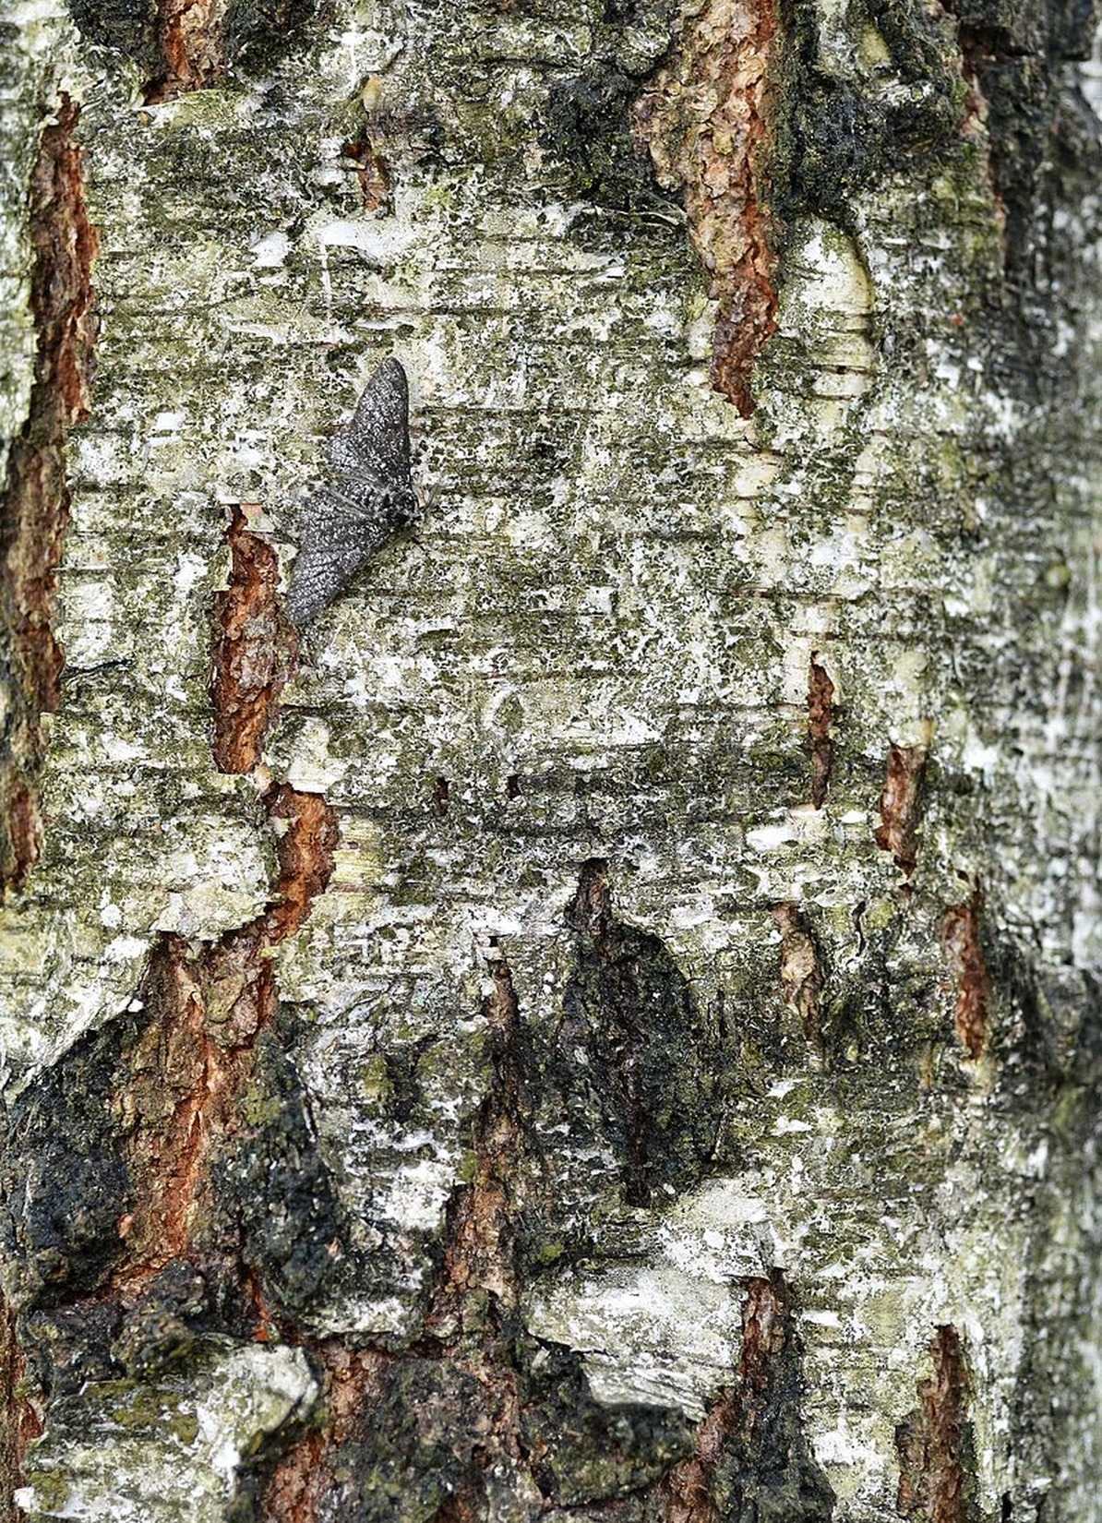
Haploid and zygotic selection
How fast can natural selection change allele frequencies?
Notes:
(1 min) Open with the photo: there is a peppered moth (*Biston betularia*) resting on this birch bark. (Its form is not confirmed: enlarged, it looks mid-grey, so it may be a shaded *typica* or the intermediate *insularia*; check the Commons description or swap the photo.) Ask the room to find it. We will come back to this moth: it is the best-known example of natural selection measured in the wild.
Guiding question for today: how fast can selection change allele frequencies, and what decides the speed?
Image: peppered moth on birch bark, carried over from the previous version of the lecture (file Biston_betularia_20110529_102239_8073M.JPG, Wikimedia Commons). Confirm author and licence before sharing the slides outside the course.

Slide 2
Haploid and zygotic selection
Calculate fitness and selection coefficients from data
Explain how the genetic system decides which selection model applies
Predict allele-frequency change under haploid selection
Explain how dominance changes the speed of zygotic selection
Estimate selection in the wild, and explain how heterozygote advantage maintains variation
Use selection models to evaluate the claims of eugenics
Notes:
(1 min) Six objectives, one per section (sections 05 and 06 both serve objective 5). They are written as general skills; the peppered moth, sickle-cell haemoglobin and PKU are the evidence we use to practise them.
Reading: Neal (2004) Chapter 10 (the models) and Chapter 11 (applying them). Note that equation numbers in these slides follow Neal's 2nd edition (2004).

Slide 3
1% → 99%
Dark morph peppered moths around Manchester, 1848 to 1898: about 50 generations. How strong must selection have been?
Notes:
(1 min) The hook. The slide says "dark morph" because students have not yet met the name *carbonaria*; it is introduced in section 05. In 1848 the black form was a collector's rarity; by the end of the century almost every peppered moth around Manchester was black. These are J.B.S. Haldane's (1924) round numbers, as reported by Neal (2004, section 11.2.1). One generation per year, so about 50 generations.
Ask: is that a lot of selection or a little? Hold the question; we answer it in section 05 (s ≈ 0.3), once we have the models.

Slide 4
Fitness and selection
01
Notes:
(10 s) First we need a way to measure how much better one genotype does than another.

Slide 5
Fitness
Absolute fitness (λ) is how many times a genotype multiplies per generation. Relative fitness (W) is λ divided by the λ of the fittest genotype, so the fittest has W = 1.
Selection coefficient: s = 1 − W. The fittest genotype has s = 0; a lethal genotype has s = 1.
Notes:
(2 min) Absolute fitness, λ, is the multiplication rate defined in the population-growth lectures (Neal Chapter 4), applied to a genotype or allele rather than to a whole population.
We usually care about relative fitness, because natural selection is about differences between types. By convention the reference is the genotype with the highest λ (Neal section 10.1).
The selection coefficient s measures the disadvantage: s = 1 − W, and W = 1 − s. It runs from 0 (the reference) to 1 (lethal, λ = 0).

Slide 6
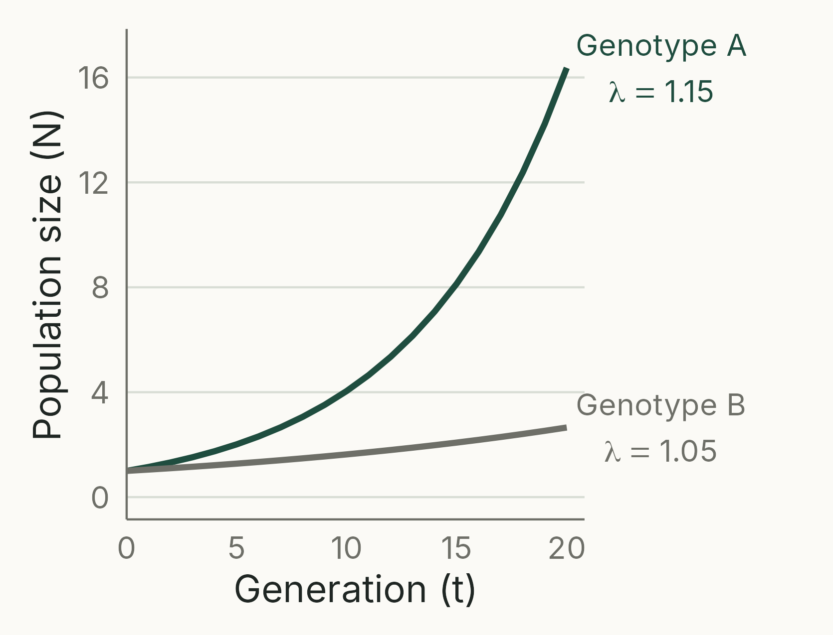
Relative fitness compares growth rates
λ_{A} = 1.15, λ_{B} = 1.05
A is fittest: W_{A} = 1
W_{B} = 1.05 / 1.15 = 0.913
s_{B} = 1 − 0.913 = 0.087
Notes:
(2 min) Kept from the previous version, redrawn. Both genotypes start from one individual and grow geometrically: N~t~ = λ^t^. After 20 generations A has about 16 descendants and B fewer than 3. A is the fittest genotype throughout the lecture.
Both genotypes are increasing, yet B is losing ground: selection is about relative, not absolute, success.
Figure: analytical (geometric growth), script 01_fitness_growth.R.

Slide 7
Which genotype is fittest, and how strong is selection against the others?
3 MIN · PAIRS
Generation 0 → 1: A 50 → 100, B 60 → 90, C 40 → 40
Calculate λ, then W, then s, for each genotype
What does s = 0.5 mean in words?
Notes:
(3 min) Neal Table 10.1.
Answers: λ = 2, 1.5, 1 for A, B, C. A is the reference: W = 1, 0.75, 0.5; s = 0, 0.25, 0.5.
s = 0.5: genotype C leaves half as many descendants per individual as genotype A.
Point out that C is not declining in number (λ = 1), but it is still being selected against.

Slide 8
Genetic systems
02
Notes:
(10 s) The same fitness differences produce different rates of change depending on how genes are packaged and passed on.

Slide 9
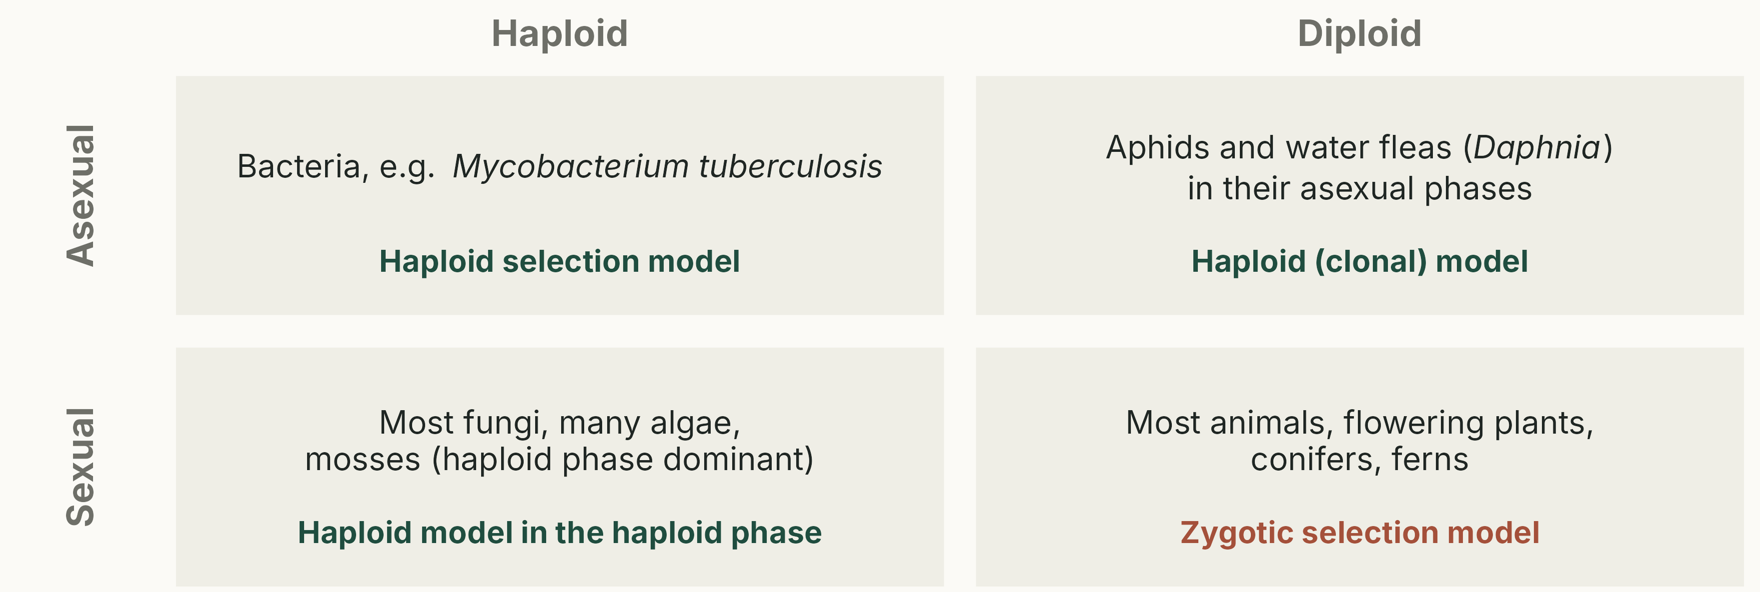
Four genetic systems, two models
Examples are typical rather than absolute: aphids, for example, are asexual in summer and sexual in autumn.
Notes:
(2 min) Columns: ploidy, the number of chromosome sets in the adult (haploid n, diploid 2n; from Greek *haploos*, single, and *diplous*, double). Rows: reproduction, asexual (offspring are copies) or sexual (alleles reshuffled every generation). Other systems exist, e.g. haplodiploid bees, ants and wasps (haploid males, diploid females), and polyploids such as tetraploid potatoes.
Ploidy decides whether an allele can be hidden by another allele in the same individual (dominance). Sex decides whether genotypes are inherited intact (clones) or rebuilt each generation from the allele pool.
Walk round the four boxes.
Correction from the previous version: dinoflagellates were listed as asexual diploids, but most dinoflagellates are haploid for most of their life cycle (only the zygote is diploid). They are replaced by aphids and water fleas (*Daphnia*), which are diploid in their asexual (parthenogenetic) phases. Avoid apomictic dandelions and many parthenogenetic whiptail lizards as examples: they are mostly triploid. Bdelloid rotifer ploidy is disputed.
The coloured line in each box says which model we will use: anything that reproduces clonally, haploid or diploid, follows the haploid selection model (Neal section 10.3). Only diploid sexual organisms need the zygotic model.
Schematic, script 02_genetic_systems.R.

Slide 10
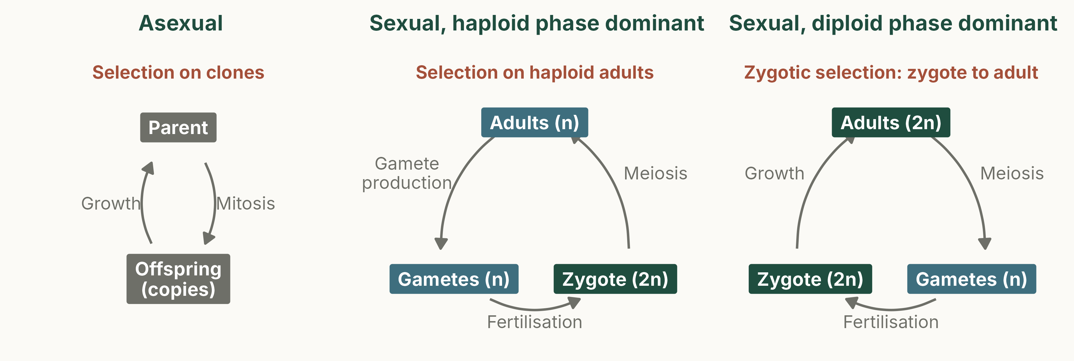
Where does selection act in the life cycle?
Blue: haploid (n) stages. Green: diploid (2n) stages. Grey: clones of either ploidy.
Notes:
(2 min) Replaces the three hand-drawn life-cycle slides.
Asexual: offspring are copies, so genotypes are inherited intact.
Haploid-dominant sexual cycle (many fungi and algae): the diploid zygote undergoes meiosis straight away (zygotic meiosis), so the long-lived, selected stage is haploid.
Diploid-dominant cycle (most animals and flowering plants): meiosis happens in the gonads of adults (gametic meiosis); the long-lived stage is diploid. Selection between zygote and adult is **zygotic selection**.
Recombination (the shuffling of alleles during meiosis) is covered later in the course.

Slide 11
Zygotic selection
Selection among diploid genotypes (A₁A₁, A₁A₂, A₂A₂) in sexual organisms. In our models it acts through differences in survival from zygote to adult.
Haploid selection acts on haploid genotypes and on whole clones (bacteria, asexual organisms, haploid life stages). Neal calls selection on gametes gametic selection.
Notes:
(1 min) The title of the lecture uses this term, so define it explicitly (the previous version never did).
Neal (section 10.2): overall fitness combines components acting in the haploid stage (gametic selection) and in the diploid stage (zygotic selection). In nature zygotic selection includes differences in reproduction too; our models use survival (viability) only and assume genotypes do not differ in fertility.
Clones follow the haploid model because the whole genotype is inherited intact, whether the clone is haploid or diploid: there is no reshuffling, so selection simply changes clone frequencies.

Slide 12
Haploid selection
03
Notes:
(10 s) The simplest model: each genotype copies itself.

Slide 13
Haploid selection: the simplest case
Each individual copies itself: A gives A, B gives B
Without selection, frequencies stay the same
With selection, the fitter type spreads until it is fixed
p = frequency of A, q = frequency of B; W_{A} = 1, W_{B} = 1 − s
Also applies to clones of any ploidy: the model tracks clone frequencies
Notes:
(2 min) Corrects a typo in the previous version ("extinction of A1 and the fixation of A1"): the disfavoured type is lost and the favoured type is fixed.
By Neal's convention, q is always the frequency of the type selected against.
Directional selection like this removes genetic variation; at the end of the lecture we meet a kind of selection that keeps it.

Slide 14
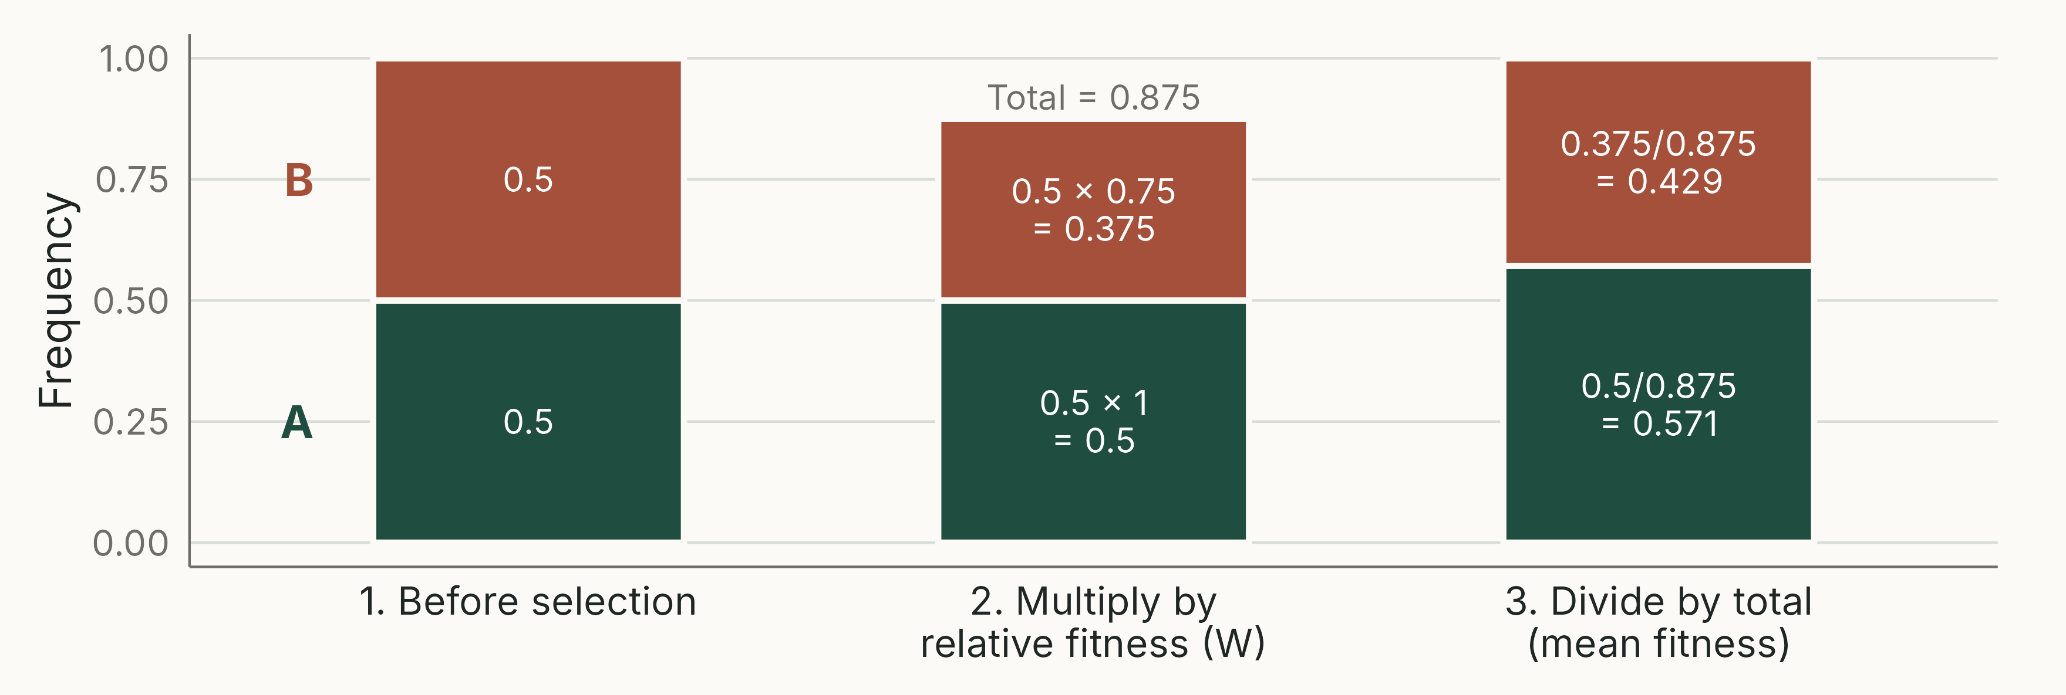
Selection is a filter
W_{A} = 1, W_{B} = 0.75 (s = 0.25). The total after step 2 is the mean fitness: the population's average relative fitness.
Notes:
(2 min) Every selection model in this lecture uses the same three steps: (1) start with frequencies; (2) multiply each by its relative fitness; (3) divide by the total so the frequencies sum to 1 again.
The total after step 2 (0.875) is the mean relative fitness of the population.
Result: A rises from 0.5 to 0.571 in one generation.
Analytical, script 04_selection_filter.R.

Slide 15
Haploid selection: a worked example
 | Genotype A | Genotype B | Total
Frequency, generation 0 | p₀ = 0.01 | q₀ = 0.99 | 1
Absolute fitness (λ) | 1.6 | 1.2
Relative fitness (W) | 1.6 / 1.6 = 1 | 1.2 / 1.6 = 0.75
Selection coefficient (s = 1 − W) | 0 | 0.25
Contribution (frequency × W) | 0.01 × 1 = 0.01 | 0.99 × 0.75 = 0.7425 | 0.7525
Frequency, generation 1 (÷ total) | 0.01 / 0.7525 = 0.013 | 0.7425 / 0.7525 = 0.987 | 1
Notes:
(4 min) Kept from the previous version, with one correction: the 'contribution' row is frequency multiplied by **relative fitness** (1 − s), not by the selection coefficient.
Walk through row by row. A starts rare (1%) and grows 1.6× per generation; B grows 1.2×. W~B~ = 1.2/1.6 = 0.75, so s = 0.25.
After one generation A has risen from 0.010 to 0.013. Slow at first, because A is rare.
Arithmetic checked in scripts/00_check_numbers.R.

Slide 16
Δq = −spq / (1 − sq)
Change in frequency of the less fit type in one generation (Neal Eqn 10.1). It depends on s, and on how common both types are (pq).
Check: q = 0.99 and s = 0.25 give Δq = −0.0033, so q falls to 0.987, as in the table.
Notes:
(2 min) This is just the table written in algebra: q after selection = q(1 − s)/(1 − sq); subtract q to get Δq (derivation in Neal Box 10.1).
The pq term is the key: change is small when either type is rare, because pq is small. That is the origin of the slow–fast–slow pattern on the next slide.
For many generations, Neal gives the exact solution q~t~ = q~0~ / [q~0~ + (1 − q~0~)(1 − s)^−t^] (Eqn 10.2). Students do not need to memorise it.

Slide 17
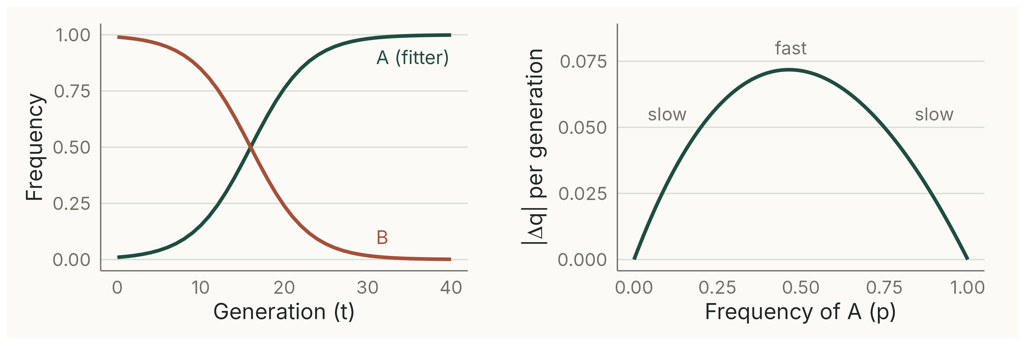
Haploid selection: slow, fast, slow
Worked example continued (p₀ = 0.01, s = 0.25). Change per generation: Δq = −spq / (1 − sq) (Neal Eqn 10.1).
Notes:
(2 min) Left: frequencies over 40 generations; A passes 50% at about generation 16 and is above 98% by generation 30. Right: the size of the change per generation against the frequency of A. Change is greatest at intermediate frequencies (here near p = 0.47; the curve is slightly skewed when s is large) and tiny when either type is rare.
The sigmoid shape is the same as logistic growth (Neal Chapter 5).
Biological consequence: a new advantageous mutation is rare for many generations, and while rare it can easily be lost by chance (genetic drift, earlier lecture).
Analytical iteration of Eqn 10.1, script 05_haploid_dynamics.R.

Slide 18
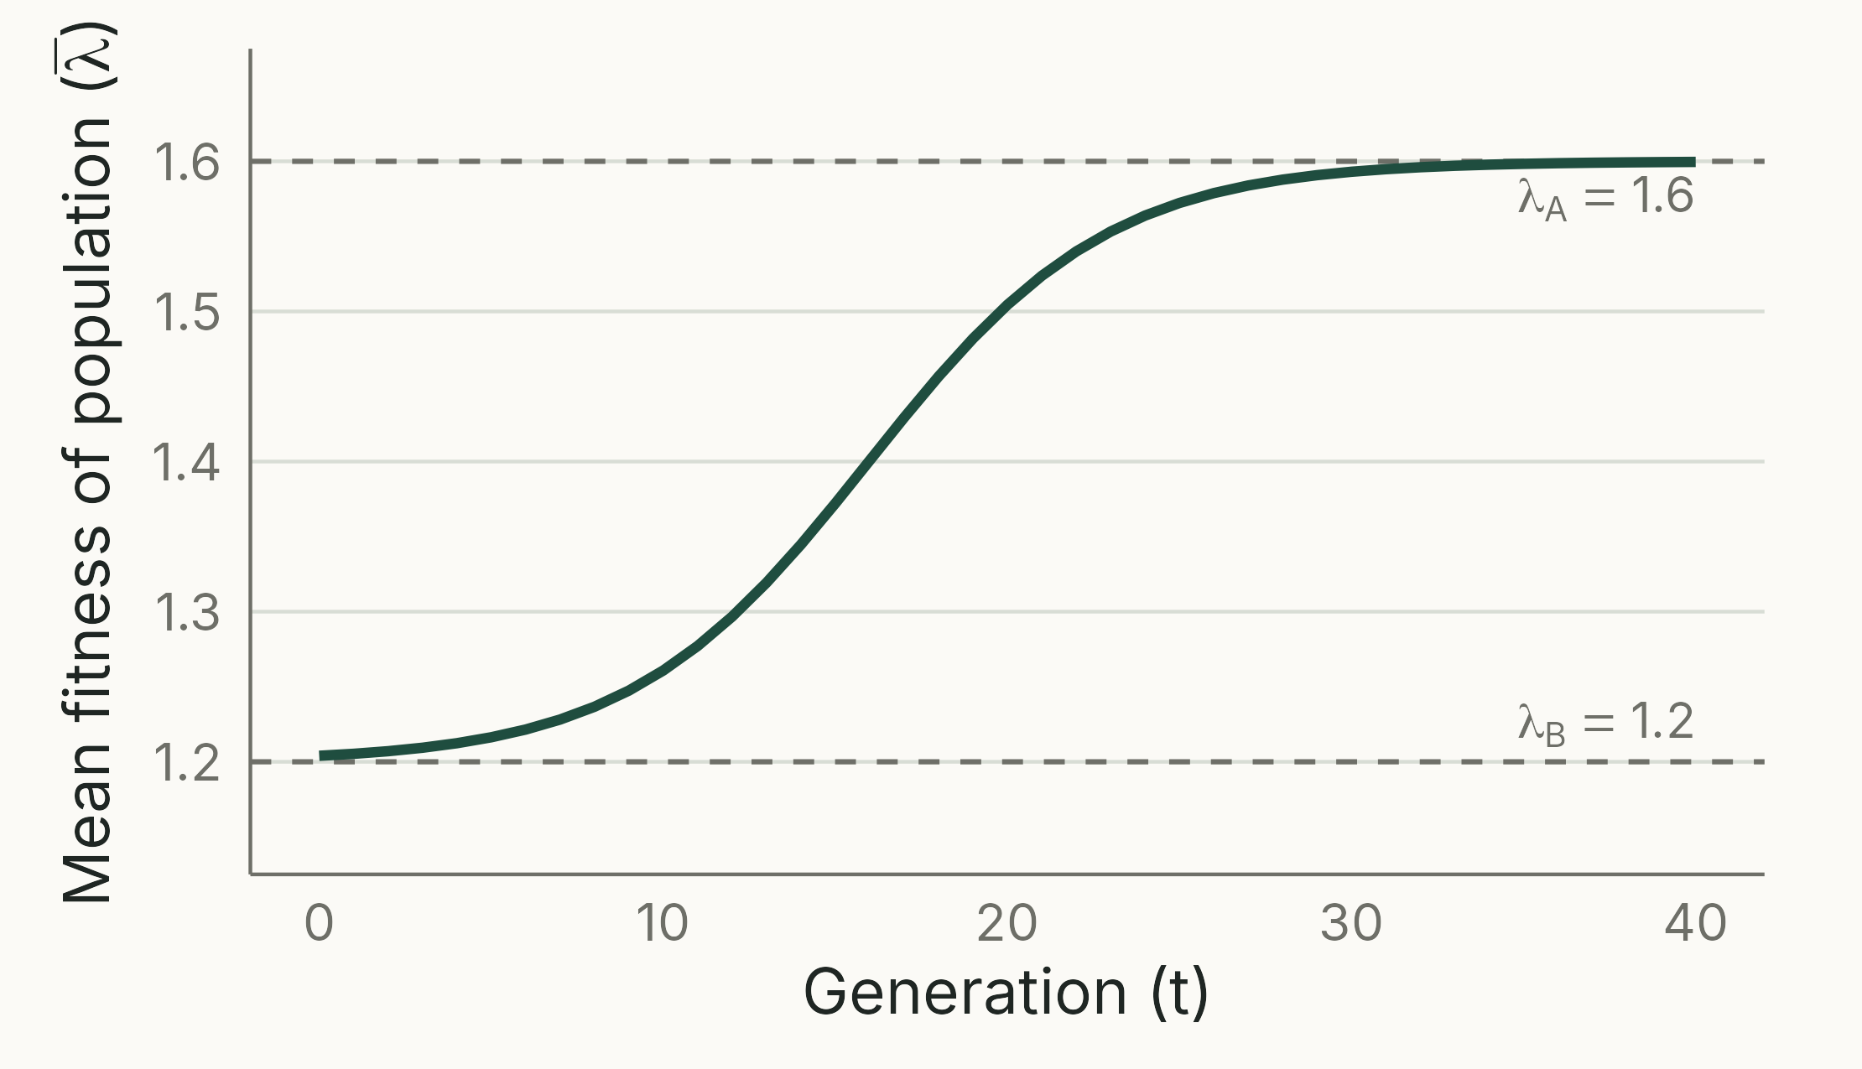
Selection raises mean fitness
TAKEAWAY
Mean fitness rises from 1.2 to 1.6 as A replaces B: selection raises the average fitness of the population.
Notes:
(1 min) Mean fitness each generation = p × 1.6 + q × 1.2 (Neal Fig. 10.2 uses λ = 2 and 1).
Neal's conclusions 3 and 4 (section 10.3.1): selection increases the overall fitness of the population, and only the ratio of growth rates matters.
Script 06_mean_fitness.R.

Slide 19
A genotype multiplies twice as fast as its rival. In which population does its frequency rise faster?
Growing population
λ = 4 versus 2
Shrinking population
λ = 0.8 versus 0.4
The same in both
Cannot tell without population sizes
Notes:
(under 1 min) Answer C. This is the point of the previous slide's model: only relative fitness matters. In both, W~B~ = 0.5 and s = 0.5, so the deterministic change in frequency is identical.
Discussion point: D is partly right in practice. A shrinking population becomes small, and then genetic drift matters; our models ignore drift.

Slide 20
Zygotic selection
04
Notes:
(10 s) Now diploid, sexually reproducing organisms: most animals and plants.

Slide 21
What changes in diploids?
HAPLOID OR CLONAL
DIPLOID AND SEXUAL
Genotype inherited intact (one allele, or a clone's whole genotype)
Offspring copy their parent
Selection changes genotype (clone) frequencies directly
Two alleles per individual
Random mating rebuilds genotypes: p², 2pq, q²
Dominance decides if selection 'sees' an allele in a heterozygote
Notes:
(2 min) Recap Hardy–Weinberg from the earlier lecture: with random mating and no evolutionary forces, genotype frequencies are p², 2pq and q². (Correction from the previous version: p² + 2pq + q² = 1 is always true; the equilibrium is that the genotype frequencies equal p², 2pq and q², and it also requires random mating.)
Genotypes are no longer independent: an A~1~A~2~ parent produces A~1~A~1~, A~1~A~2~ and A~2~A~2~ offspring. So we track allele frequency q and rebuild genotypes each generation.
Dominance here means dominance **with respect to fitness**, which can differ from dominance for the visible phenotype (Neal Example 11.3 calls this pleiotropy).

Slide 22
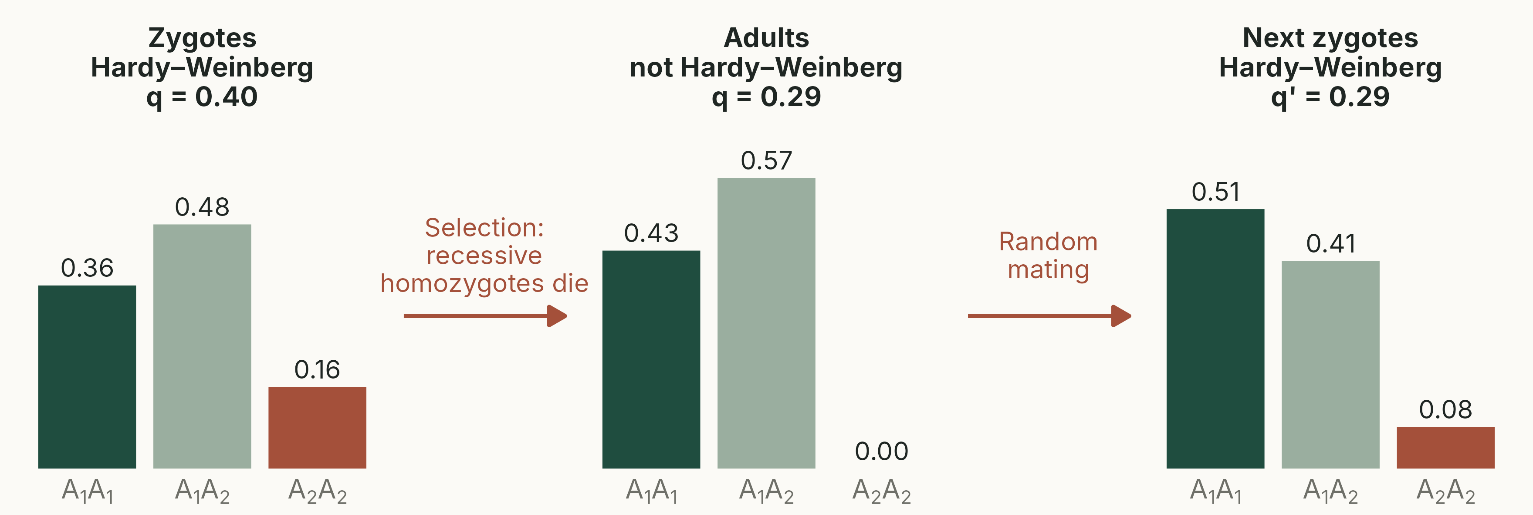
One generation of zygotic selection
Recessive lethal (W = 1, 1, 0). Selection breaks Hardy–Weinberg proportions; random mating restores them at the new q.
Notes:
(2 min) The cycle that the circular arrow on the old table was trying to show. It uses a recessive lethal rather than the worked example's s = 0.3, because with weak selection the adults' departure from Hardy–Weinberg proportions is too small to see (0.409 / 0.464 / 0.127 against 0.411 / 0.460 / 0.129).
Zygotes start in Hardy–Weinberg proportions at q = 0.4: 0.36 / 0.48 / 0.16. All A~2~A~2~ die, so adults are 0.36/0.84 = 0.43 and 0.48/0.84 = 0.57: no homozygotes for A~2~, far from Hardy–Weinberg. Their gametes carry A~2~ at q' = 0.57/2 = 0.286. Random mating restores Hardy–Weinberg proportions at the new q: 0.51 / 0.41 / 0.08. The next slide works through the same steps with weaker selection.
(The old slide's 33% / 33% / 33% starting frequencies were not Hardy–Weinberg proportions for any q; this version uses consistent numbers.)
Script 07_zygotic_cycle.R.

Slide 23
Zygotic selection: a worked example
 | A₁A₁ | A₁A₂ | A₂A₂ | Total
Zygote frequency (q = 0.4) | p² = 0.36 | 2pq = 0.48 | q² = 0.16 | 1
Relative fitness (W) | 1 | 1 − ½s = 0.85 | 1 − s = 0.70
Contribution (frequency × W) | 0.36 | 0.408 | 0.112 | 1 − sq = 0.88
Adult frequency (÷ 0.88) | 0.409 | 0.464 | 0.127 | 1
New allele frequency | q' = 0.127 + ½ × 0.464 = 0.359
Notes:
(3 min) Same three steps as the haploid filter, applied to genotypes. No dominance (Neal Case B): the heterozygote's fitness is halfway between the homozygotes.
Correction from the previous version: the last row is the genotype frequency in **adults after selection**, not in the next generation. To get the next generation, calculate the new allele frequency, then apply Hardy–Weinberg.
Check with Neal Eqn 10.4: Δq = −½spq/(1 − sq) = −0.5 × 0.3 × 0.6 × 0.4 / 0.88 = −0.041, so q' = 0.359.

Slide 24
Four cases of dominance
Case | A₁A₁ | A₁A₂ | A₂A₂ | Neal's label
No dominance | 1 | 1 − ½s | 1 − s | Case B
Favoured allele (A₁) dominant | 1 | 1 | 1 − s | Case C
Favoured allele (A₁) recessive | 1 | 1 − s | 1 − s | Case D
Heterozygote superior | 1 − s₁ | 1 | 1 − s₂ | Case E
Relative fitness of each genotype. A₁ is favoured; A₂ (frequency q) is selected against. In the last case both homozygotes are selected against.
Notes:
(3 min) Neal Table 10.3 and 10.4. Cases are named on the slide by what happens to the favoured allele; Neal's letters are given so students can find them in the book. Selection is always against A~2~, whose frequency is q.
Δq in one generation (Neal Eqns 10.4 to 10.7; for reference, not on the slide): no dominance −½spq/(1 − sq); favoured dominant −spq²/(1 − sq²); favoured recessive −sp²q/(1 − 2sq + sq²); heterozygote superior pq(s~1~p − s~2~q)/(1 − s~1~p² − s~2~q²).
Neal's example: insect body colour under bird predation. Case B: green, olive and brown insects on green vegetation. Case C: green dominant, brown insects eaten on green vegetation. Case D: the same insects once the vegetation turns brown. Case E: olive heterozygotes best camouflaged on olive vegetation.
Students should recognise the fitness pattern of each case from data; they do not need to memorise the Δq formulas.
Case E has an equilibrium where Δq = 0: q̂ = s~1~ / (s~1~ + s~2~) (Neal Eqn 10.15). We use it for sickle-cell haemoglobin.
From here on, cases are named by the favoured allele in words (Neal's C = favoured dominant, D = favoured recessive), and figures plot the favoured allele's frequency, p.
Why no Case A? Neal starts his lettering at B; the haploid model plays the role of the simplest case.

Slide 25
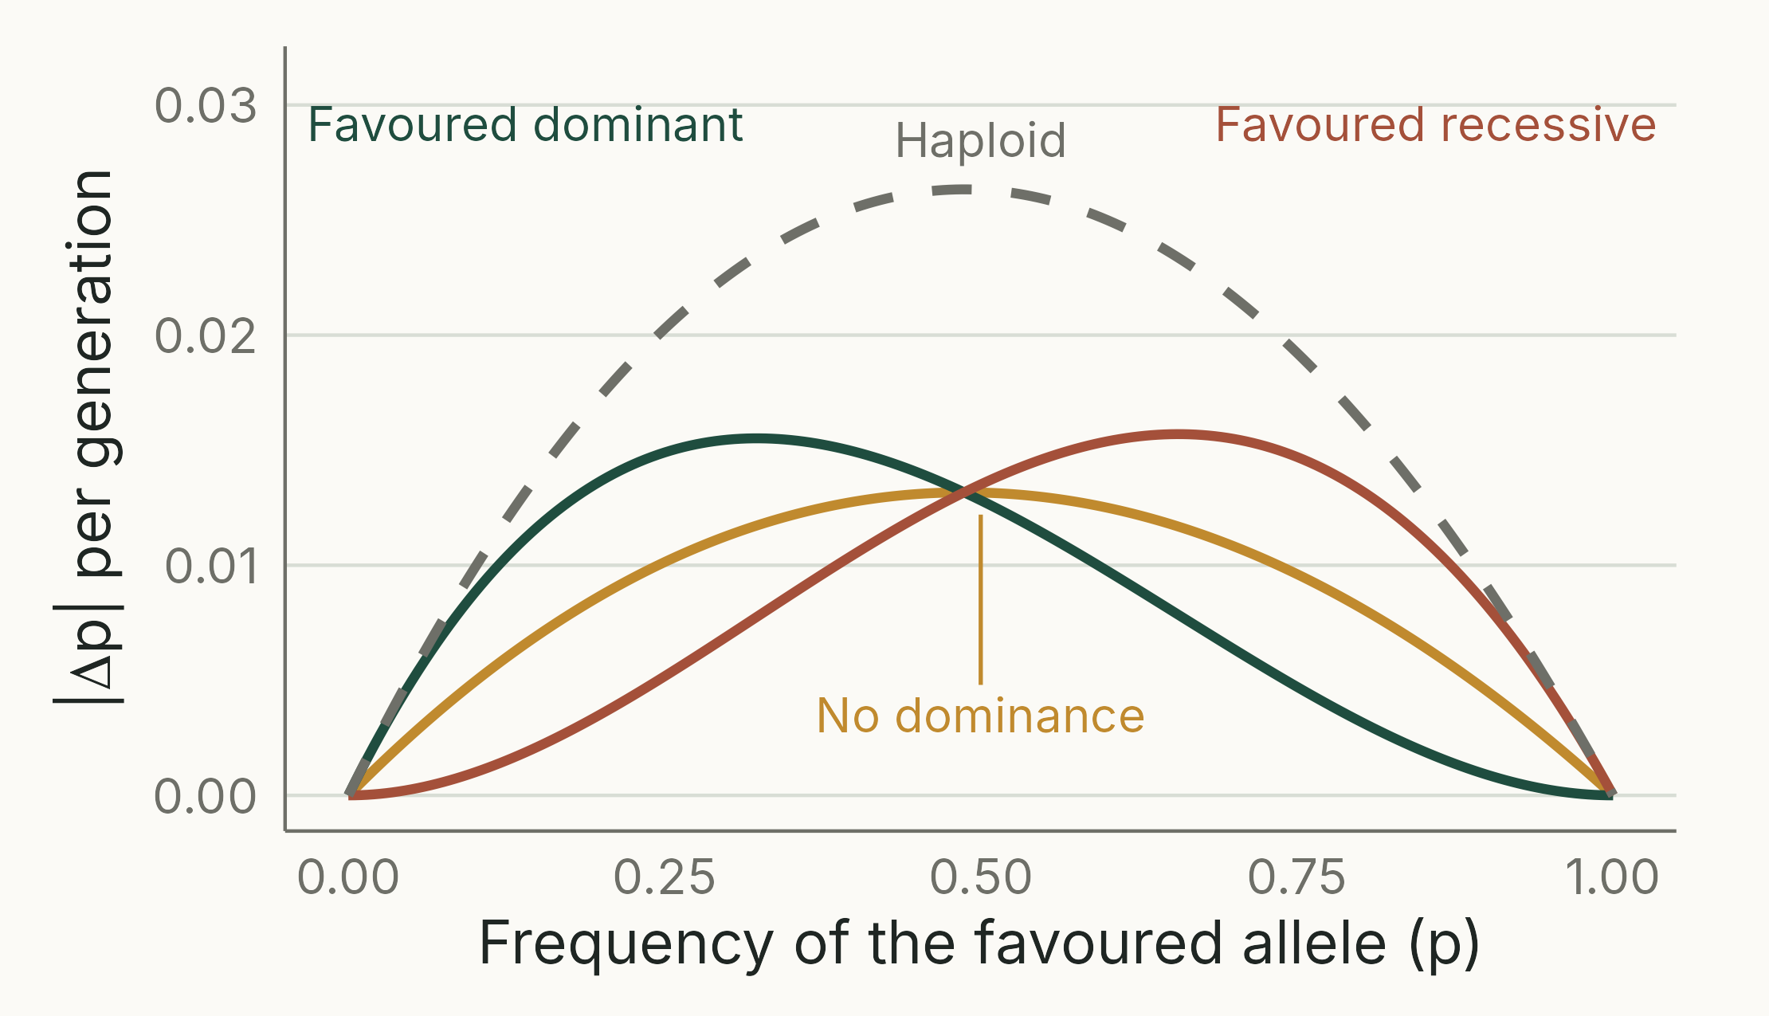
Dominance shifts the fastest change
TAKEAWAY
A rare favoured recessive allele hides in heterozygotes, so it barely changes while p is small (red).
Notes:
(2 min) Neal Fig. 10.3a, redrawn with s = 0.1 and flipped to show the frequency of the **favoured** allele (p = 1 − q), so the axis matches the next slide. The haploid model (dashed) is added for comparison.
Peaks: no dominance at p ≈ 0.5; favoured dominant (Case C) at p ≈ 0.33; favoured recessive (Case D) at p ≈ 0.67 (Neal section 10.4.1, point 3, gives the same peaks in terms of q; checked numerically in 00_check_numbers.R).
Read it from both ends: a favoured recessive is slow while rare (left of the red curve); a favoured dominant is slow when nearly fixed (right of the green curve), because the last disfavoured recessive copies hide in heterozygotes.
With no dominance, Δq is exactly half the haploid value (compare Eqns 10.1 and 10.4), because the homozygote's disadvantage s is shared out at s/2 per allele.
Script 08_dq_by_case.R.

Slide 26
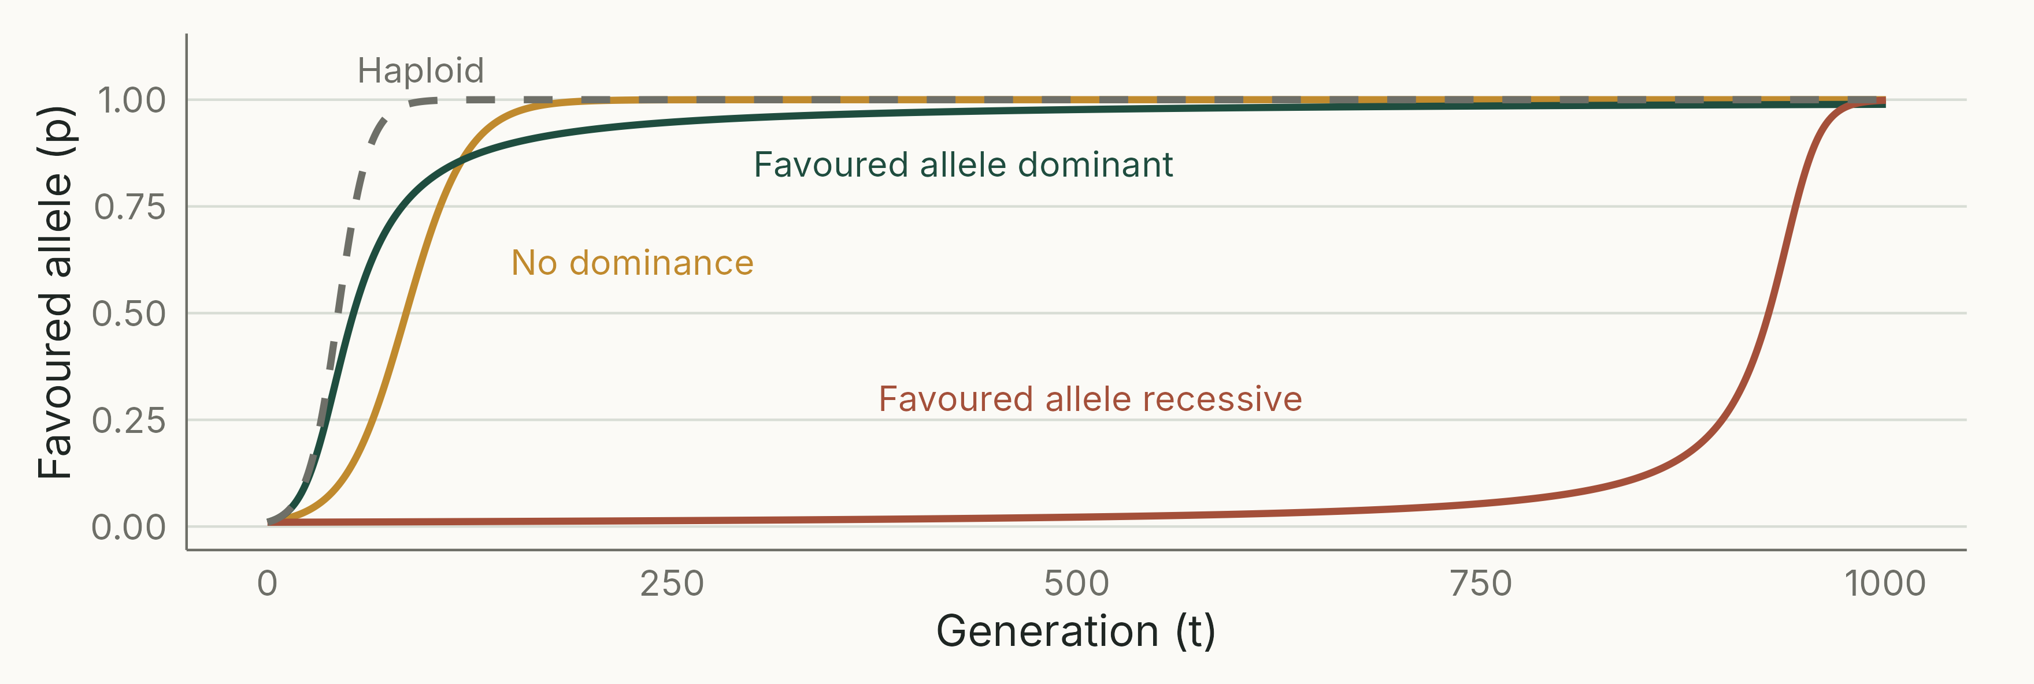
How fast does a favoured allele spread?
s = 0.1, p₀ = 0.01 (compare Neal Fig. 10.4). Deterministic: real rare alleles are often lost by drift first.
Notes:
(3 min) Replaces the textbook figure (ho04f06) with the same comparison drawn from our own models.
Haploid (dashed) is fastest: >99% in about 90 generations. No dominance: about 175 generations.
A favoured dominant allele rises fastest of the diploid cases while rare (it is expressed in heterozygotes) but then crawls towards fixation: it is still below 99% after 1,000 generations, because the disfavoured allele survives hidden in heterozygotes.
A favoured recessive allele is almost invisible to selection while rare: it takes about 900 generations even to reach 50%.
Correction from the previous version: 'dominant alleles reach fixation relatively rapidly' is not right. They **increase** rapidly but **fix** slowly (Neal section 10.4.1, point 7).
Script 09_spread_by_case.R.

Slide 27
100,000
generations for a favoured recessive allele to go from 0.1% to 50% (s = 0.01); nine-tenths of that time is spent below 1%. A dominant allele gets to 50% in about 800.
Notes:
(1 min) Same starting point (0.1%), same s (0.01); only dominance differs. Deterministic iteration of Neal's models (00_check_numbers.R):
Favoured allele recessive (Case D): 0.1% to 1% in 89,332 generations; 0.1% to 50% in 99,493.
No dominance (Case B): 459 and 1,372.
Favoured allele dominant (Case C): 231 and 787.
Neal Table 10.5 (after Crow 1986) gives matching values for the 0.1% to 1% step (90,150, 459 and 231).
Why: at p = 0.001, almost every copy of the allele is in a heterozygote (only a fraction p of copies are in homozygotes). A recessive allele is not expressed there, so selection cannot see it; a dominant allele is expressed in every carrier. Once the recessive allele reaches 1%, it gets to 50% in about another 10,000 generations.
Caveat: the models ignore drift. In a real population a recessive allele at 0.1% would very probably be lost by chance long before selection could act.
A frequency of 0.001 is one new mutation in a population of 500 diploid individuals (2N = 1,000 gene copies).
Extension (mirror image): a favoured dominant allele is slow at the other end. Going from 99% to 99.9% takes it about 90,000 generations, because the last disfavoured recessive copies hide in heterozygotes (see the previous slide's figure).

Slide 28
Which new advantageous mutation takes longest to start spreading?
In a haploid bacterium
Diploid, no dominance
Diploid, dominant
Diploid, recessive
Notes:
(2 min) Answer D. While rare, a recessive allele occurs almost only in heterozygotes, where it is not expressed, so selection cannot see it. It is also at the mercy of drift for longer.
Follow-up: which case takes longest to reach fixation once common? C (favoured dominant), because the last copies of the disfavoured recessive hide in heterozygotes.

Slide 29
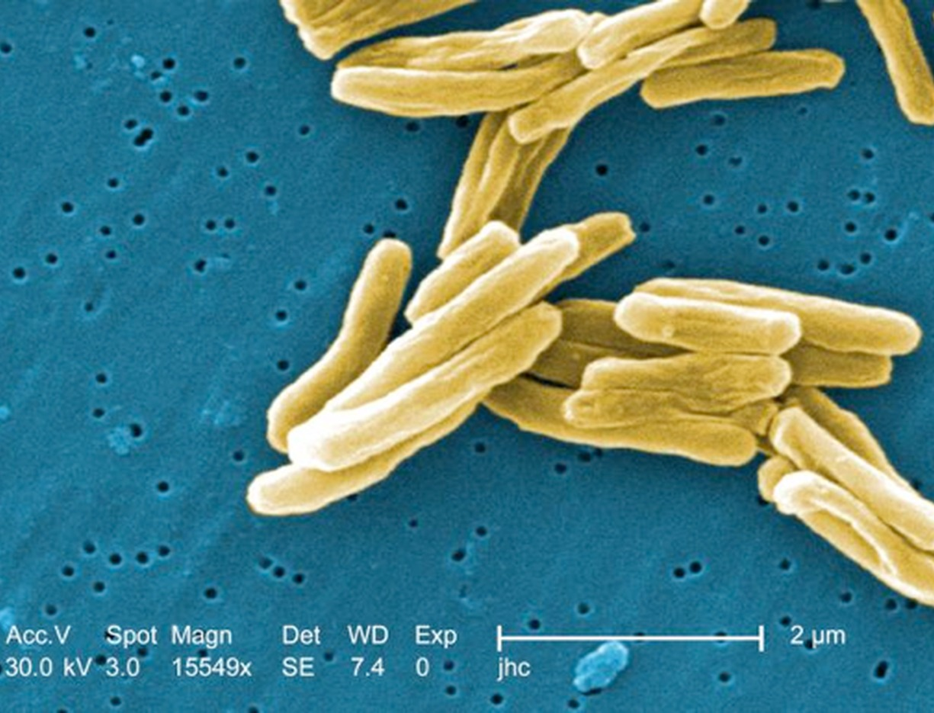
Why it matters: microbes evolve fast
Haploid: new mutations are never hidden
Generations of hours, huge populations
Drug resistance in TB can evolve within one patient
Hosts keep up through sex and immunity
Notes:
(2 min) Most microbes are haploid; most animals and plants are diploid. Time in our models is measured in generations, and bacterial generations are short.
Correction from the previous version: 'haploid asexual pathogens will tend to win coevolutionary struggles with diploid sexual hosts' overstates the case. Ploidy is one advantage among several (generation time and population size matter more), and hosts persist; the Red Queen idea comes later in the course.
TB treatment uses several drugs together for months because resistance to a single drug evolves readily.
Image: scanning electron micrograph of *Mycobacterium tuberculosis* (CDC Public Health Image Library; public domain), carried over from the previous version.

Slide 30
What the models tell us
Change is fastest at intermediate frequencies, where variation in fitness is greatest
For the same s, haploid change is twice as fast as diploid with no dominance
Rare recessives hide in heterozygotes: slow to spread if favoured, slow to remove if harmful
A favoured dominant spreads fast but takes very long to fix
The more variation in fitness, the faster mean fitness rises (Fisher)
Notes:
(2 min) Synthesis of Neal section 10.4.1.
Correction from the previous version: Fisher's (1930) 'fundamental theorem of natural selection' (not 'of evolution') concerns the rate of increase in **mean fitness**, and it is the **additive** genetic variance in fitness, not total genetic variance, that sets it. That is why dominance shifts the peak of Δq away from q = 0.5.
On the slide this is simplified to 'more variation in fitness, faster change', because additive genetic variance is not introduced until the quantitative genetics lecture. Precise statement: the rate of increase in mean fitness due to natural selection equals the additive genetic variance in relative fitness (divided by mean fitness in absolute terms).
The 'twice as fast' bullet depends on Neal's definition of s (the diploid homozygote has fitness 1 − s, the heterozygote 1 − s/2).
Assumptions behind all of these models (Neal section 10.5): one locus of large effect; constant selection; no mutation, migration, drift or linkage to other selected genes.

Slide 31
Industrial melanism
05
Notes:
(10 s) Back to the peppered moth: now we can answer the opening question.

Slide 32
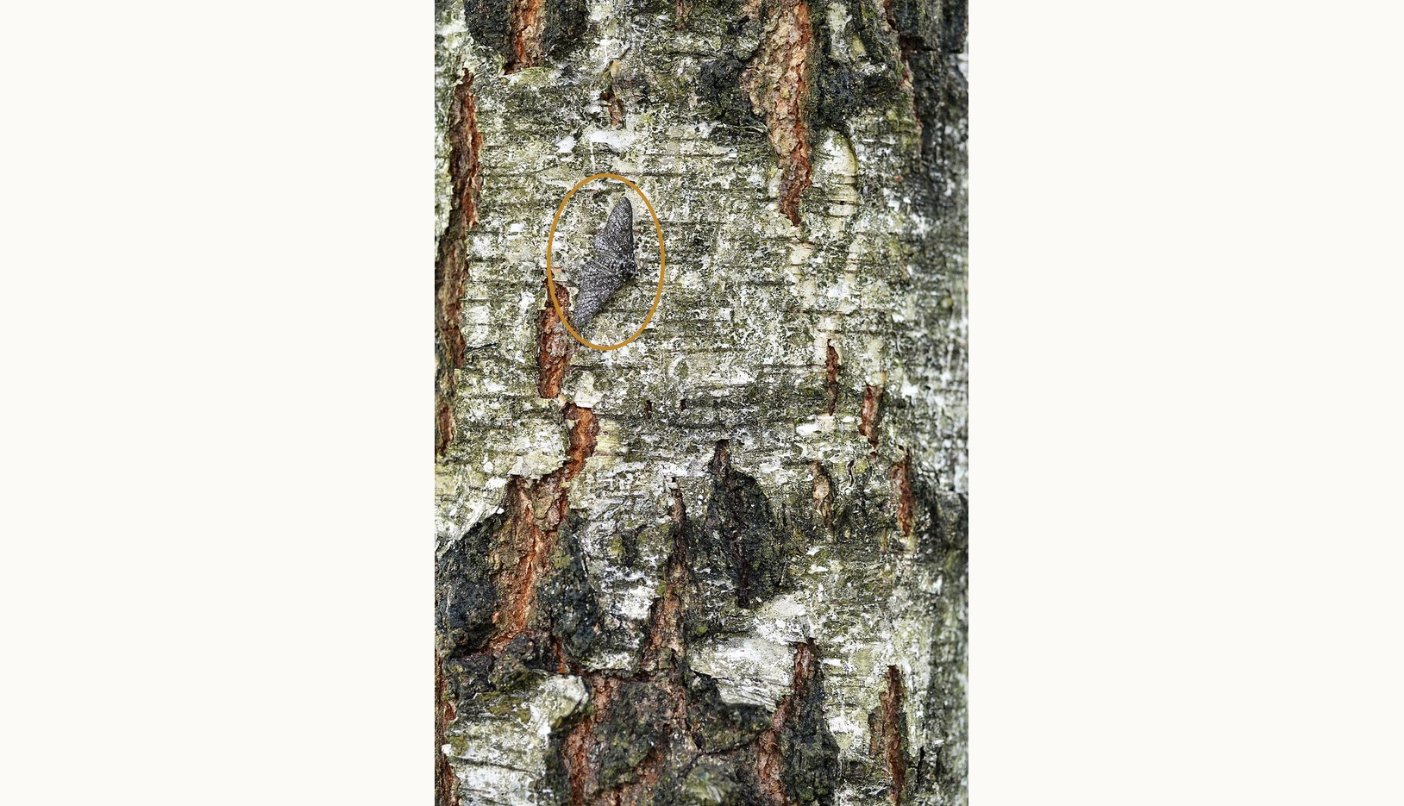
Did you spot the moth?
THE OPENING PHOTO
A peppered moth on lichen-covered birch bark. Camouflage like this is what birds select on.
Notes:
(1 min) The reveal for the title-slide photo. Ask who found it. Now imagine the same bark blackened by soot: a pale moth would stand out, and a black one would vanish. (The moth's form is unconfirmed; it may be a shaded *typica* or the intermediate *insularia*.) That is the hypothesis this section tests.
Image: as on the title slide (file Biston_betularia_20110529_102239_8073M.JPG, Wikimedia Commons; licence to confirm), with the moth circled.

Slide 33
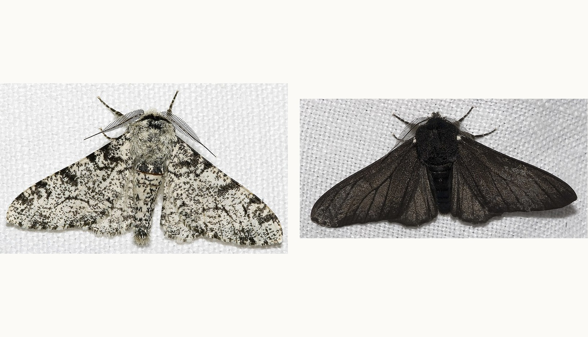
The peppered moth, Biston betularia
TWO FORMS
typica (left) is pale; carbonaria (right) is black and dominant. The carbonaria allele is a transposable element in the cortex gene that arose in the early 1800s.
Notes:
(1 min) Other dark forms (*insularia*) exist; following Neal, we treat the system as two alleles with *carbonaria* (C) dominant to *typica* (c).
New since the textbook: van't Hof et al. (2016) Nature 534: 102–105 identified the mutation as a large transposable element inserted in the *cortex* gene, and dated its origin to about 1819. That is a statistical estimate with an uncertainty of a few decades, which is why the slide says 'early 1800s': the first known *carbonaria* specimen was caught before 1811 (next slide). (Correction from the previous version: 'a single mutation' is right, but its nature is now known.)
Images: Olaf Leillinger, Wikimedia Commons (files Biston.betularia.7200.jpg and Biston.betularia.f.carbonaria.7209.jpg), CC BY-SA 2.5 as far as I know: please confirm on Commons before redistributing.

Slide 34
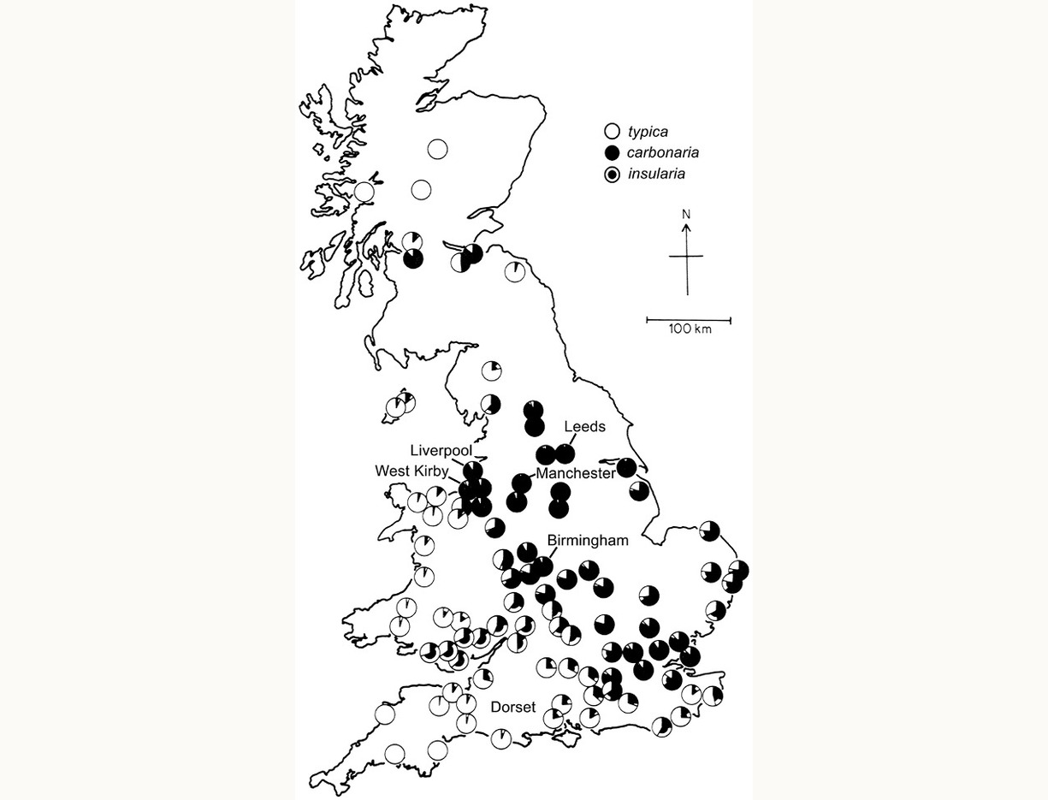
The rise of carbonaria
First specimens: before 1811, then Manchester 1848
By the 1890s: over 90% near Manchester
Spread by migration; rose where favoured
Soot darkened bark; pollution killed lichens
Map: 20th-century survey data (Lees 1981, via Neal 2004)
Notes:
(2 min) Neal section 11.2.1. Corrections from the previous version: the first *carbonaria* was caught 'prior to 1811' (exact date unknown; the specimen is in Oxford). 'It spread rapidly through migration' is incomplete: migration carried the allele between areas, but selection explains why it became common in industrial areas and stayed rare in rural ones.
Map: frequencies of *typica* (white), *carbonaria* (black) and *insularia* in Britain, from Lees (1981) as reproduced in Neal (2004) Fig. 11.3 (carried over from the previous version; the copyright is Elsevier's, so keep it for teaching use only).
Note Norfolk and Lincolnshire: rural but downwind of the industrial Midlands.
The map shows 20th-century survey data (compiled by Lees 1981), not the 19th-century spread: say so when showing it.

Slide 35
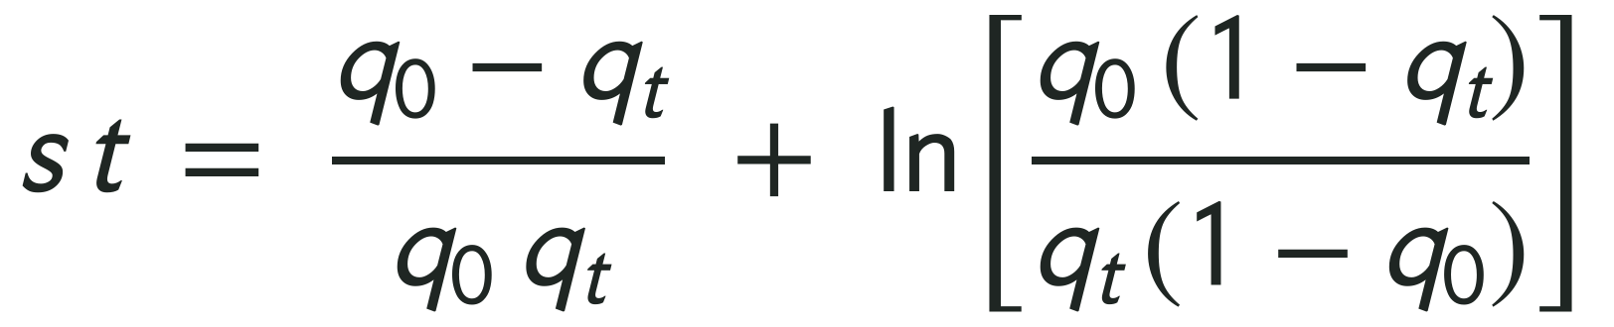
Haldane's question: how strong?
Year | carbonaria (CC + Cc) | typica (cc) = q² | Allele frequency of c (q)
1848 | 0.01 | 0.99 | q₀ = √0.99 = 0.995
1898 | 0.99 | 0.01 | q_{t} = √0.01 = 0.10
carbonaria is the favoured, dominant allele (Neal's Case C); t = 50 generations.
Solve Neal's approximate Eqn 10.11 for s (accurate when s is small):
Notes:
(3 min) Set-up, following Haldane (1924) and Neal (2004) section 11.2.1.
*typica* is the recessive homozygote cc, so its frequency is q². In 1848 typica = 0.99, so q~0~ = √0.99 = 0.995. In 1898 typica = 0.01, so q~t~ = √0.01 = 0.1.
Selection is against the recessive: Neal's Case C. 50 years = 50 generations (one generation per year).
Correction from the previous version: the reference is Neal (2004) Eqn 10.11 in section 11.2.1, not 'Box 15.1' (that was the 1st edition).

Slide 36
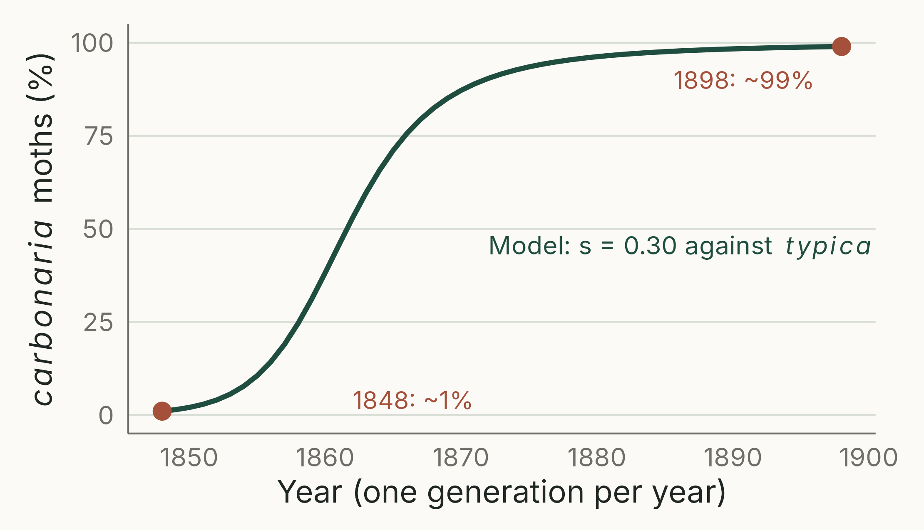
Selection against typica was strong
TAKEAWAY
1% to 99% in 50 generations needs s = 0.30 (exact; Neal's approximation gives 0.33): typica had about 70% of the fitness of carbonaria.
Notes:
(2 min) The line is the model with the exact value of s (0.30), found by iterating Case C until it reproduces 1% and 99% in 50 generations. Neal's approximate equation (Eqn 10.11) gives s = 0.33, so W~typica~ = 0.67; equivalently *carbonaria* had about a 50% advantage (1/0.67 = 1.49), which is how Haldane expressed it.
Iterating the exact model gives s = 0.30. Neal warns that the approximations are accurate only when s is small (about 0.01); with s this large the approximation overestimates by about 10%. Either way, selection was far stronger than anyone then thought possible.
The cause was already suspected: Tutt (1896) proposed differential bird predation on soot-darkened bark. What came about 30 years after Haldane was the field evidence (Kettlewell).
Model trajectory: deterministic Case C, script 10_haldane_carbonaria.R; the two points are Haldane's round figures, not a time series.

Slide 37
How many generations would carbonaria take to rise from 10% to 90%?
4 MIN · PAIRS
Relative fitness W = 0.67: typica leaves 67% as many offspring as carbonaria
Convert phenotype frequencies to q (typica = q²); which case applies?
Solve Neal's approximate Eqn 10.11 for t, with s = 1 − W = 0.33:
Notes:
(4 min) Neal problem 11.4, 2(a). W = 0.67 is Neal's value (from his approximate equation); the exact value from the previous slide is 0.70. Either gives a similar answer.
q~0~ = √0.90 = 0.949; q~t~ = √0.10 = 0.316. Case C, s = 0.33.
Eqn 10.11: st = (q~0~ − q~t~)/(q~0~q~t~) + ln[q~0~(1 − q~t~)/(q~t~(1 − q~0~))] = 2.11 + 3.70 = 5.81, so t ≈ 17.6 generations. Exact iteration: 16 generations.
So most of the change in Manchester could have happened in under 20 years.

Slide 38
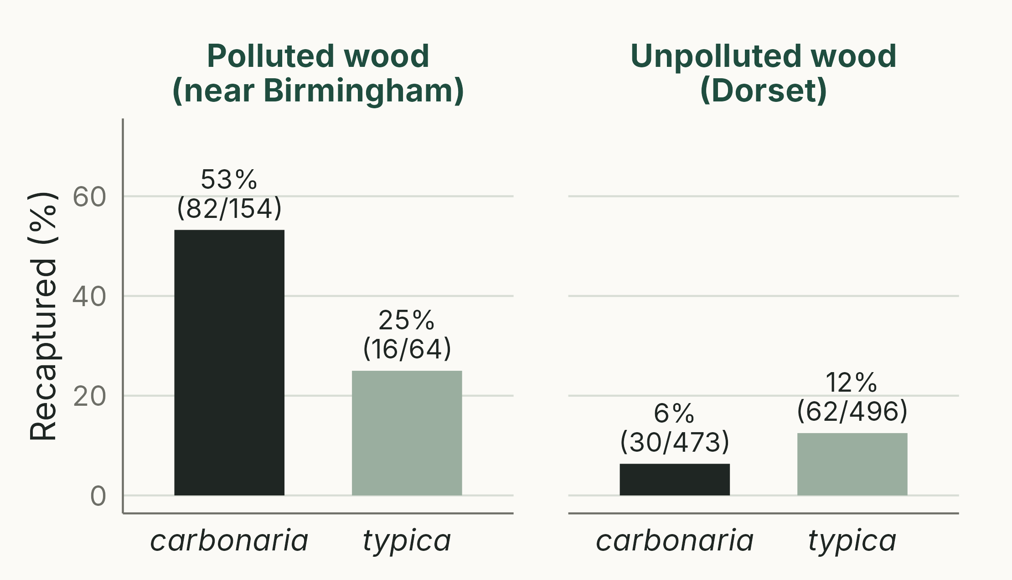
Camouflaged moths survive better
TAKEAWAY
Kettlewell released marked moths and trapped them again days later. If both forms are equally likely to be trapped, each survived about twice as well where it was camouflaged.
Notes:
(3 min) H.B.D. Kettlewell (1955, 1956) released marked moths of both forms in a polluted wood near Birmingham and an unpolluted wood in Dorset, then recaptured them at light traps over the following days (data: Neal Table 11.1).
Relative survival (ratio of recapture rates): typica in Birmingham 0.25/0.53 = 0.47; carbonaria in Dorset 0.063/0.125 = 0.51. So each form survived about half as well where conspicuous (2.1 and 2.0 times better where camouflaged). This assumes both forms are equally likely to be recaptured: a recapture probability shared by both forms cancels in the ratio.
Do not use Neal's 'log-corrected' values (0.45 and 0.75, Table 11.1 and Example 11.2). The ratio of log survival rates is a ratio of mortality rates, not a relative fitness, and with recapture data it depends on the unknown recapture probability: Dorset gives 0.75 if every survivor is trapped but about 0.41 if only 20% are.
These data show differential survival, not its cause; recapture rates also depend on dispersal and on how moths respond to traps. The evidence that birds were responsible comes next: Kettlewell, with Niko Tinbergen, filmed birds taking resting moths, which convinced sceptics who doubted that birds ate many moths.
(The previous version attributed the dead-moth experiments to Kettlewell; those were mainly by others, e.g. Bishop 1972: see next slide.)
Script 11_kettlewell.R.

Slide 39
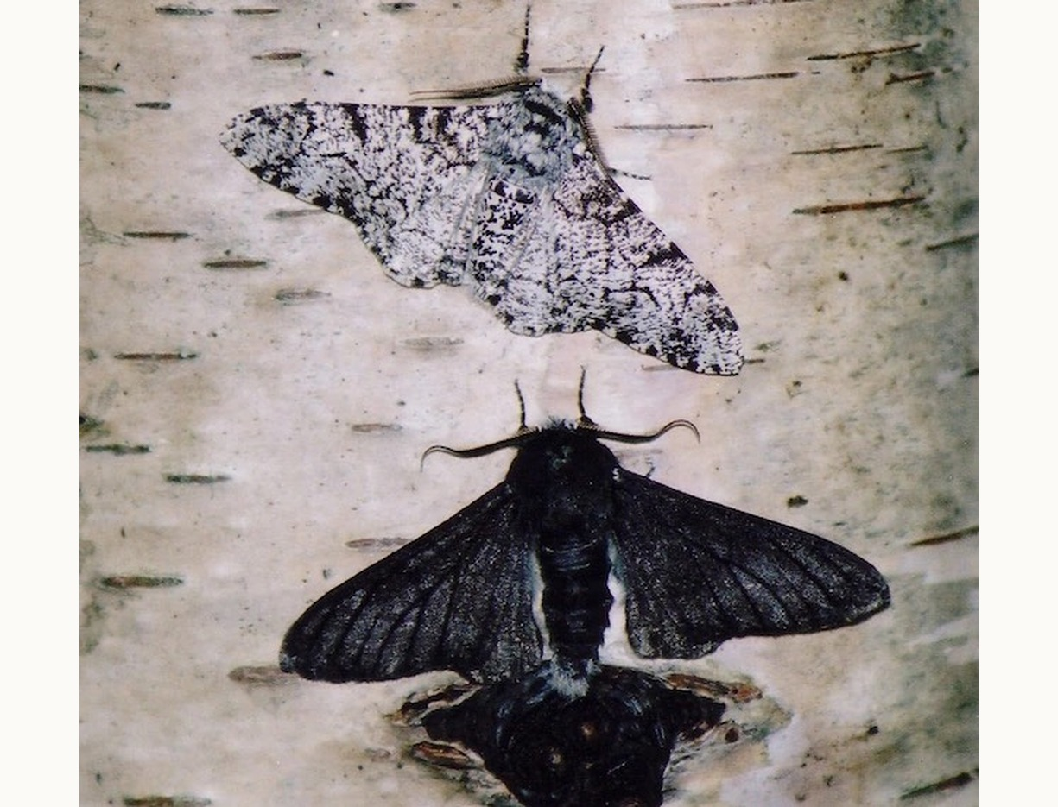
Bird predation: criticised, then confirmed
Kettlewell and Niko Tinbergen filmed birds eating the moths that did not match the bark
Critics objected that the moths were released at unnaturally high densities, onto trunks where they rarely rest
Michael Majerus repeated the test near Cambridge: 4,864 moths released one at a time, at natural densities, over six years
Birds ate more carbonaria, which is now conspicuous on clean bark: s ≈ 0.09 per day (not per generation)
Posed specimens of typica (top) and carbonaria on birch bark
Notes:
(2 min) Kettlewell's methods were criticised from the 1970s onwards, and the peppered moth became a target for creationist attacks in the 1990s and 2000s.
Majerus designed the definitive test: moths released singly at night into a 1 ha rural garden, resting positions recorded, survival checked next morning, and bird predation watched with binoculars (nine bird species). He died in 2009; the results were published by Cook, Grant, Saccheri and Mallet (2012) Biology Letters 8: 609–612. Maximum-likelihood selection against *carbonaria*: 0.091 per day (95% CI 0.028–0.157). Stress the units: this is per day of adult life, so it cannot be compared directly with the per-generation values of s elsewhere in the lecture (e.g. 0.3 from Haldane).
Other studies, e.g. Bishop (1972), pinned dead moths to trunks and found the same pattern.
Image: posed specimens of the two forms on bark (the caption says so; staged photographs like this were themselves part of the criticism). Carried over from the previous version; source and licence to confirm.

Slide 40
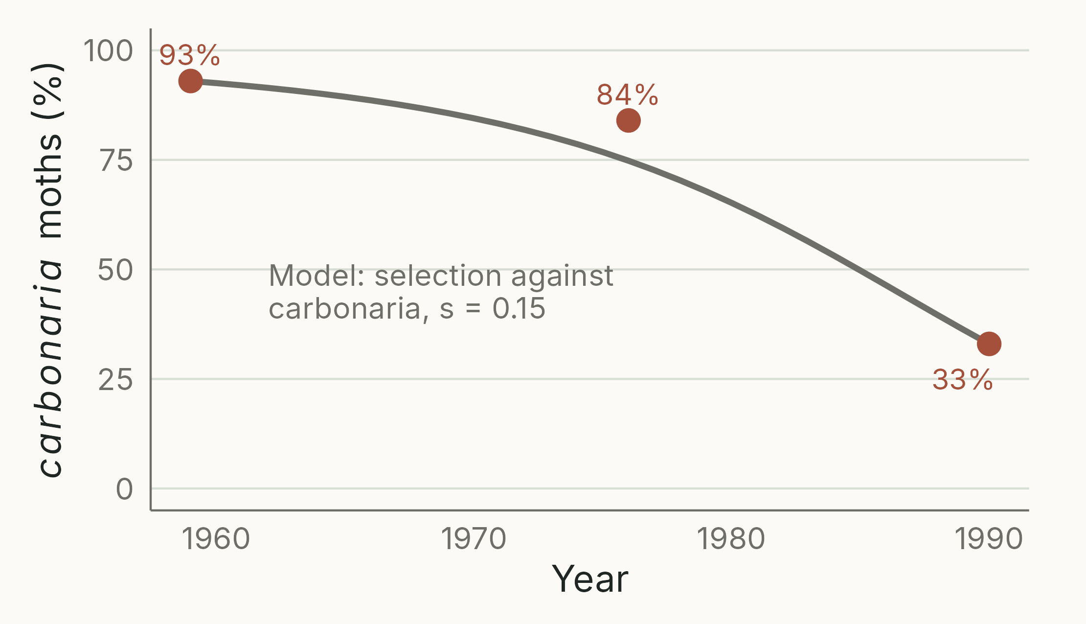
After the Clean Air Act of 1956
TAKEAWAY
The UK Clean Air Act (1956, extended 1968) reversed selection: the dominant carbonaria allele is now selected against West Kirby: 93% to 33% in 31 years, s ≈ 0.15.
Notes:
(2 min) Data: West Kirby, near Liverpool (Neal section 11.2.1): 93% (1959), 84% (1976), 33% (1990).
If students use Neal's equations: q is always the allele selected against, so here q is the *carbonaria* allele (in Haldane's calculation it was *typica*). In words: the favoured allele (*typica*) is now recessive. Now *carbonaria* is the dominant allele being selected against: Neal's Case D. After the Clean Air Act (1956).
The constant-s model misses the 1976 point (75% predicted, 84% observed), consistent with selection strengthening over time. typica = p², so p = √(typica frequency).
Exact fit from 1959 to 1990: s = 0.15 (Neal's approximation gives 0.16). Fitting each interval separately (Neal) gives 0.11 for 1959–1976 and 0.23 for 1976–1990: selection strengthened as soot and sulphur dioxide fell. Not because lichens returned: Clarke et al. (1993, J. Lepid. Soc. 47:17) report that at West Kirby *typica* replaced *carbonaria* 'in the virtual absence of such lichens'; lichen recovery lagged behind the decline.
Correction from the previous version: the main UK legislation was the Clean Air Act 1956 (extended 1968), not the 1960s–1970s.
*carbonaria* is now rare across Britain. Selection reversed, and the moth is close to its pre-industrial state.
Script 12_west_kirby.R.

Slide 41
Heterozygote advantage
06
Notes:
(10 s) Case E: when the heterozygote is fittest, selection keeps both alleles.

Slide 42
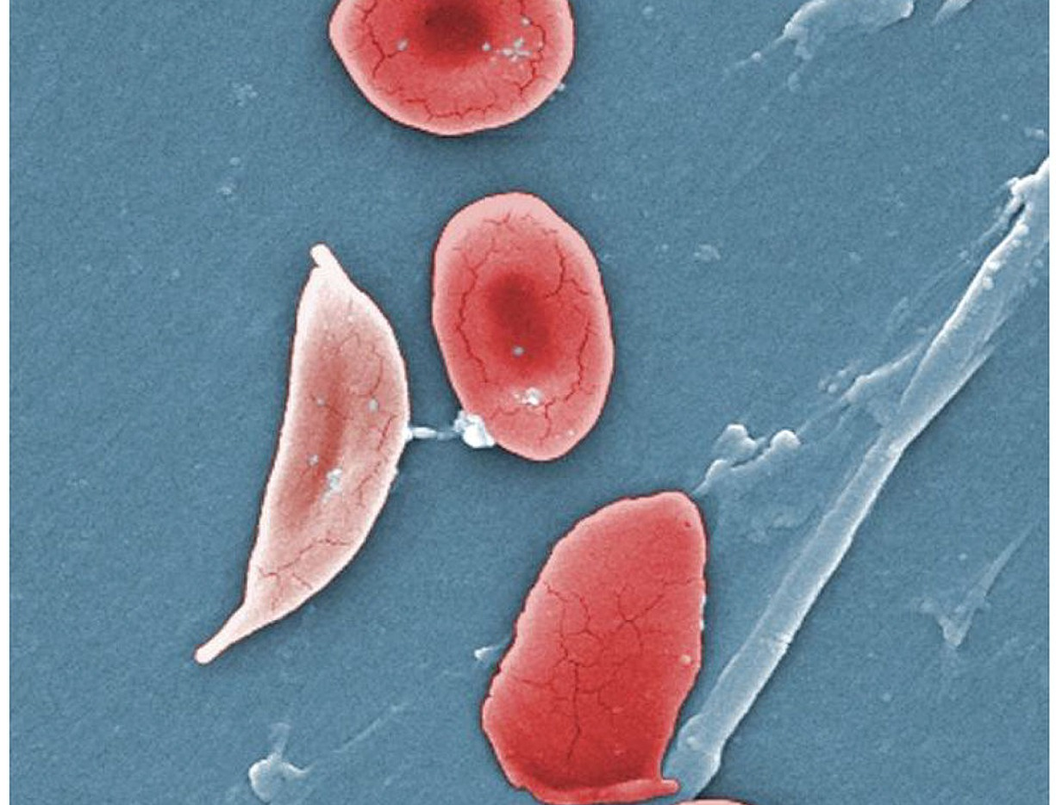
Sickle-cell haemoglobin
HbS: a point mutation in β-globin
SS: sickle-cell disease; often fatal in childhood without treatment
AS: usually healthy, and protected against severe malaria
AA: no sickle-cell disease, but vulnerable to malaria
Notes:
(2 min) Corrections from the previous version: the malaria protection belongs to heterozygous carriers (AS), not to people with sickle-cell disease (SS). 'SS = death' was true historically in malarial Africa without treatment, but with modern care many people with sickle-cell disease live into adulthood, so phrase this carefully. Protection in AS individuals is strong against severe malaria but not complete.
Image: normal red blood cells and a sickle cell, coloured scanning electron micrograph (file 1911_Sickle_Cells.jpg, OpenStax Anatomy and Physiology, CC BY 4.0, as far as I know: confirm), carried over from the previous version.

Slide 43
Fitness in Tanzania (Allison 1956)
 | AA | AS | SS | Total | q (HbS)
Infants (number) | 189 | 89 | 9 | 287
Infants (frequency) | 0.659 | 0.310 | 0.031 | 1 | 0.186
Adults (number) | 400 | 249 | 5 | 654
Adults (frequency) | 0.612 | 0.381 | 0.008 | 1 | 0.198
Survival ratio (adult ÷ infant frequency) | 0.929 | 1.228 | 0.244
Relative fitness (W) | 0.757 | 1 | 0.199
Selection coefficient | s₁ = 0.24 | 0 | s₂ = 0.80
Notes:
(3 min) Allison (1956) genotyped 287 infants and 654 adults in Tanzania (Neal Table 11.3). Neal calls the ratio of adult to infant frequency 'absolute fitness'; the slide calls it a survival ratio, because that is what it is. It compares two different groups sampled at the same time (not the same children followed to adulthood), and it measures survival only. We assume the genotypes are equally fertile, which is probably not true.
The relative fitnesses fit Case E: s~1~ = 0.24 against AA (malaria), s~2~ = 0.80 against SS (sickle-cell disease).
Note on numbers: the previous slide's values (λ = 1.228 and 0.244; W~SS~ = 0.199) are correct. Neal's printed 0.2420 and 0.1971 for SS are rounding differences: he divided the rounded frequencies (0.0076 / 0.0314 = 0.2420).
Expected HWE in infants from q = 0.186: 0.662, 0.303, 0.035 (observed 0.659, 0.310, 0.031).

Slide 44
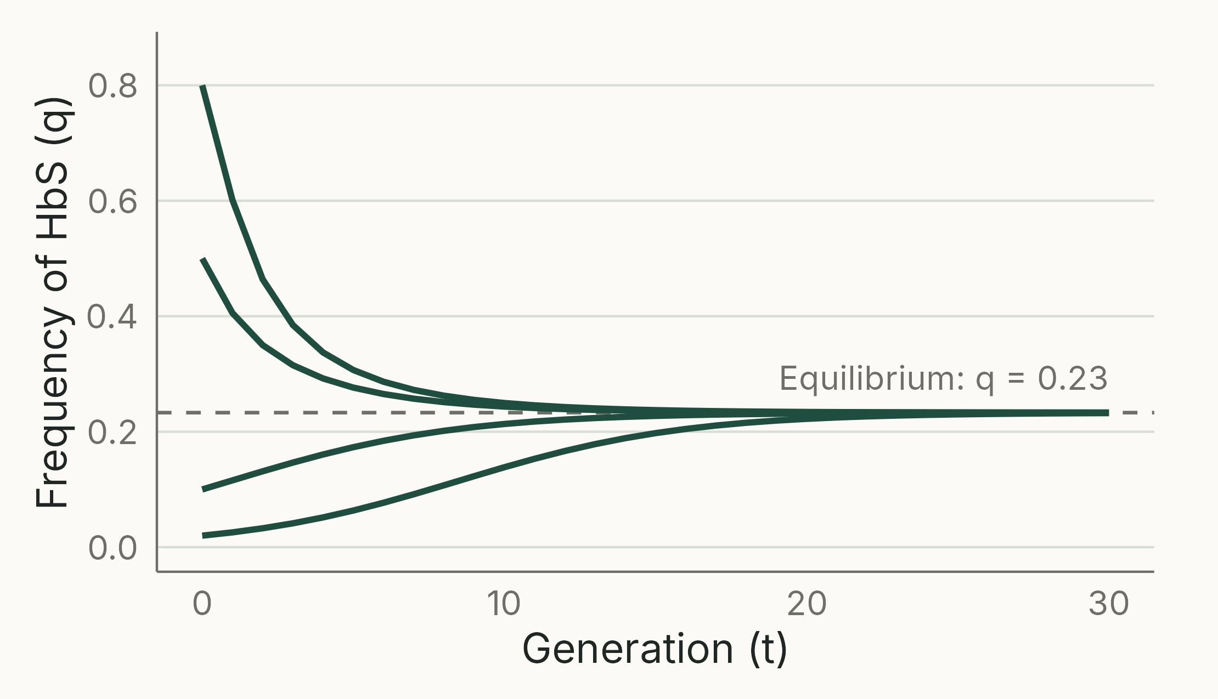
Heterozygote advantage keeps both
TAKEAWAY
Equilibrium q = s₁ / (s₁ + s₂) = 0.23, close to the 0.19 to 0.20 observed. Selection keeps both alleles: a balanced polymorphism.
Notes:
(2 min) Neal Eqn 10.15. At equilibrium Δq = 0, which happens when s~1~p = s~2~q.
Trajectories use the fitnesses estimated on the previous slide (deterministic, four starting frequencies). The model predicts 0.23; the observed 0.19–0.20 is close, given that only survival (not fertility) was measured.
This links back to the 'heterozygote advantage' slide in the mutation and genetic variation lecture, which used stylised fitnesses; these are the estimated ones.
Script 13_sickle_equilibrium.R.

Slide 45
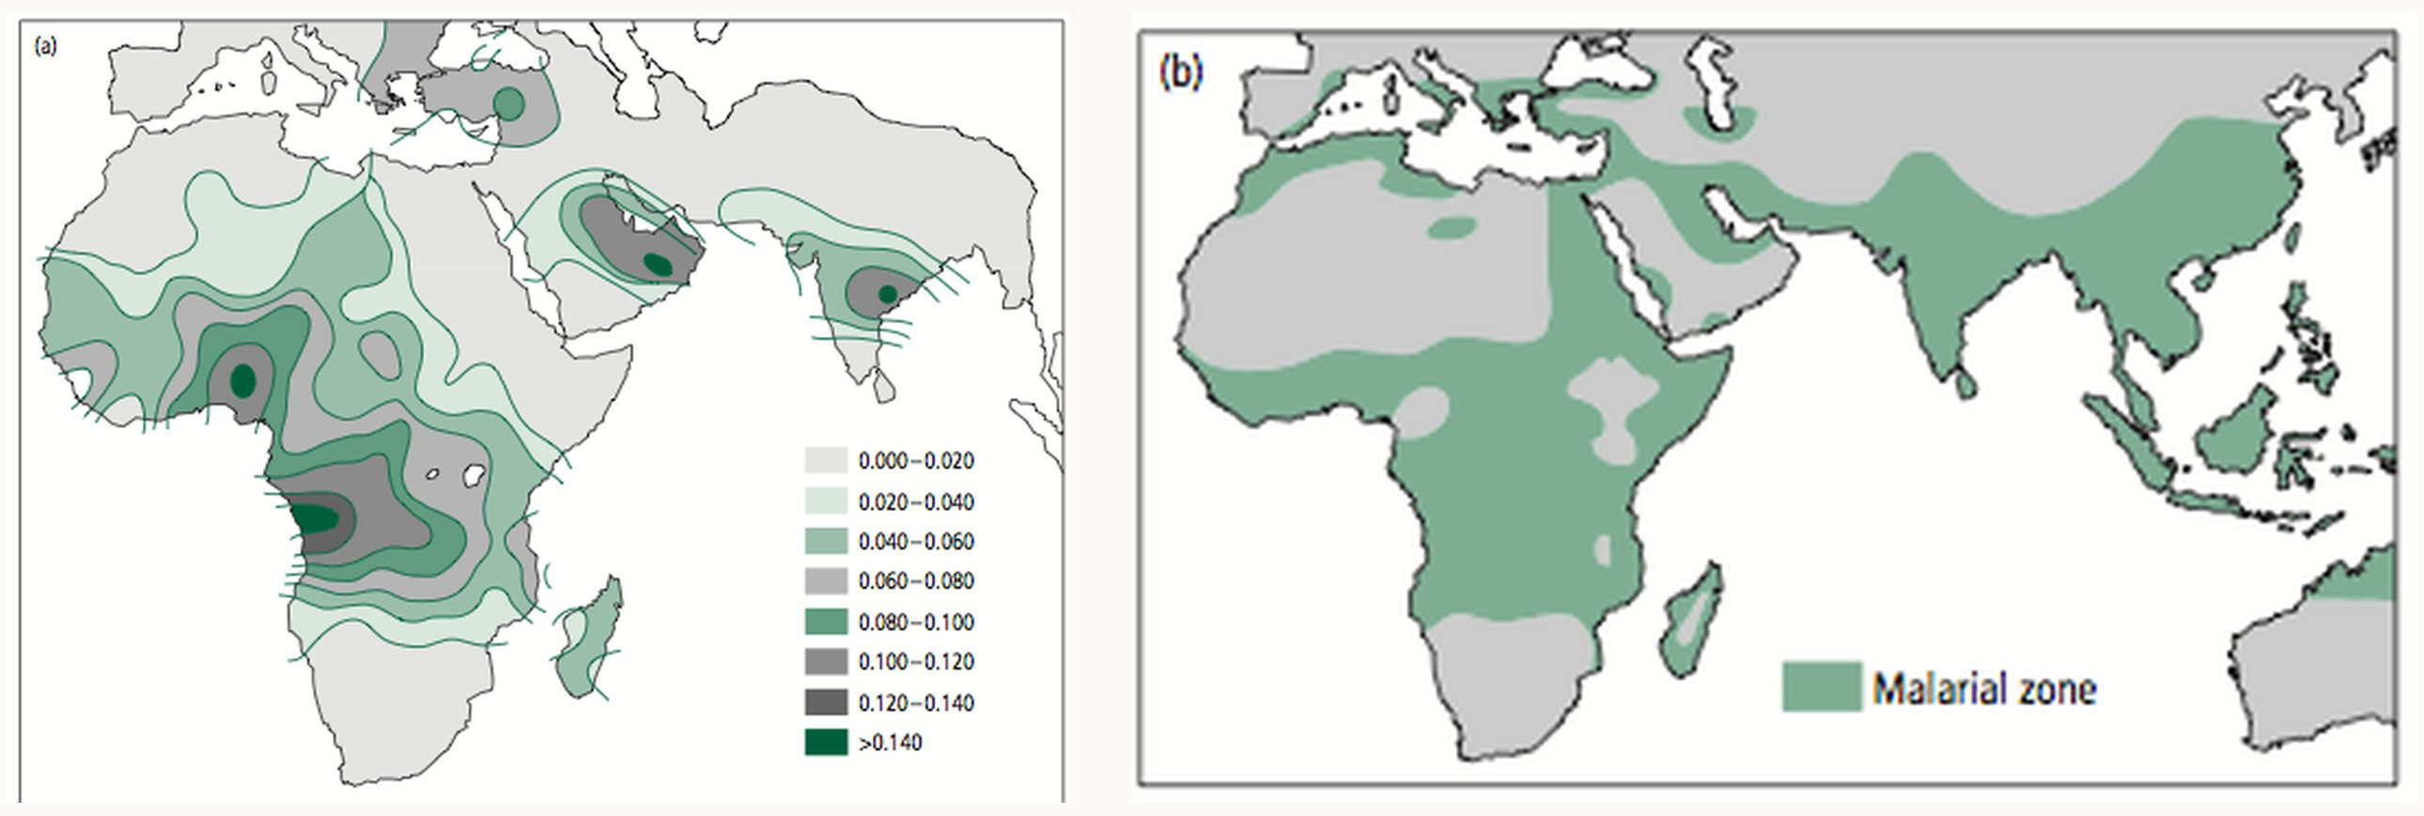
Where malaria is common, so is HbS
(a) HbS allele frequency; (b) historical range of malaria. Without malaria, HbS declines, but slowly.
Notes:
(2 min) Say: HbS is common only where malaria is, or was. Without malaria it declines, but slowly, because most copies are in healthy carriers. Heterozygote advantage is one way selection maintains genetic variation.
The map is now shown as two large panels; the source image is low resolution, so a better copy would help.
Correction from the previous version: the heterozygote is not 'maladaptive' outside malarial regions; it simply loses its advantage, while SS remains strongly disadvantageous, so the S allele declines.
I have removed the '~2% per generation decline in the US Black population'. Neal (section 11.2.2) gives a different figure (about 7% per generation, part of it due to gene flow), and neither has a primary source I could check. If you want a number, cite a primary source.
Map: (a) HbS allele frequency and (b) historical distribution of malaria. Carried over from the previous version; source not recorded (a textbook figure). Add the credit to the slide caption once known.

Slide 46
Selection against recessive alleles
07
Notes:
(10 s) Case C with s = 1, and why it matters for a dark chapter of history.

Slide 47
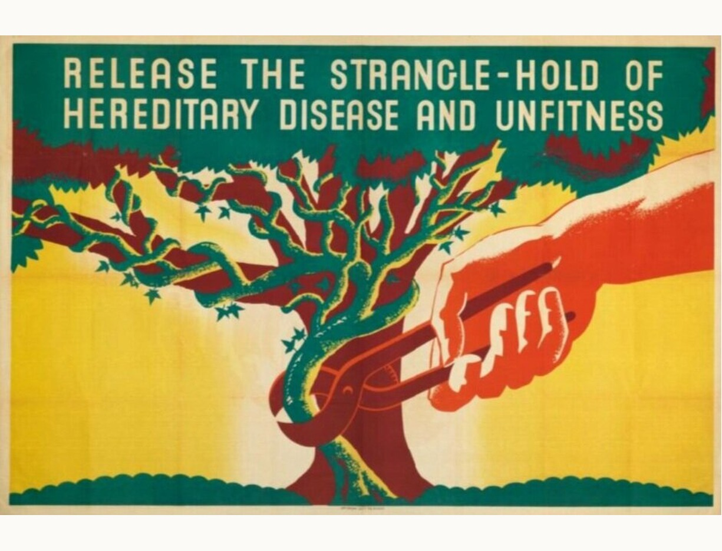
Eugenics
Aim: stop people with 'undesirable' traits from reproducing
Sterilisation laws in many countries; in Denmark about 11,000 people were sterilised, 1929 to 1967, many without free consent
Ethically indefensible, and genetically ineffective
Notes:
(2 min) The main objection to eugenics is ethical: it violates individual rights and was used to justify forced sterilisation and, under the Nazis, murder. The Nordic countries all had sterilisation laws; Denmark's ran from 1929 to 1967 (nordics.info, Aarhus University), and about 11,000 people were sterilised (European Disability Forum). The 1929 act was nominally voluntary; later laws (1934 onwards) allowed sterilisation without consent (to verify against a Danish source before quoting the details). The previous version called it 'a foolish endeavour'; the ethical point should come first, then the science.
Image: 1930s eugenics poster, 'Release the strangle-hold of hereditary disease and unfitness', carried over from the previous version; source and licence to confirm.

Slide 48
99%
of the alleles behind a recessive condition seen in 1 in 10,000 births are carried by healthy heterozygotes. Selection on affected people cannot see them.
Notes:
(1 min) Incidence q² = 1/10,000, so q = 0.01. Carriers: 2pq = 0.0198, about 1 person in 50. Each carrier has one copy and each affected person two, so the fraction of copies in carriers is pq/(pq + q²) = p = 0.99.
Correction from the previous version: 'Carriers must be homozygous to have the disease' should read 'People must be homozygous to have the disease; carriers are heterozygous and unaffected.'

Slide 49
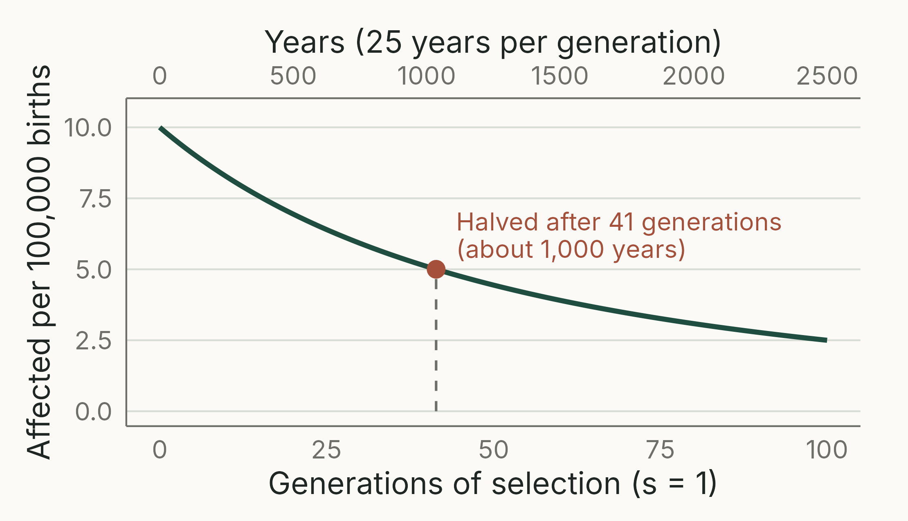
Removing a rare recessive is very slow
TAKEAWAY
Even with s = 1, halving an incidence of 1 in 10,000 takes 1/q_{t} − 1/q₀ = 41 generations: about 1,000 years.
Notes:
(3 min) Phenylketonuria (PKU) is recessive and occurs in about 1 in 10,000 births in Europe (roughly 1 in 12,000 in Denmark). It is now detected by newborn screening and treated with diet, so people with PKU live normal lives: an example where treatment, not selection, is the answer.
Calculation (Neal Eqn 10.13, Case C with s = 1): q~0~ = 0.01, q~t~ = √0.00005 = 0.00707, so t = 141.4 − 100 = 41 generations, about 1,000 years at 25 years per generation. Exact iteration: 42. (The equation was missing from the previous slide.)
Neal Example 11.5: a dictator wanting a recessive trait reduced from 1 in 10,000 to 1 in 1,000,000 would wait 1,000 − 100 = 900 generations, about 22,500 years. This ignores new mutations, which would slow it further.
Script 14_eugenics.R.

Slide 50
Mutation–selection balance
New mutations replace the alleles selection removes
Achondroplasia in Denmark (Mørch 1941): 10 in 94,075 births; s = 0.80
Mutation rate, estimated two ways: 4.3 × 10⁻⁵ per generation
When selection is already strong, more selection changes little: even s = 1 gives 8.5 rather than 10.6 per 100,000
Notes:
(2 min) HIDDEN by default to keep the lecture within time; unhide it if there is time. Neal Example 11.6 and Box 11.1; a Danish study.
Framing: present this as the population genetics of new mutations, not as a policy question. Coming straight after the eugenics slides, avoid any wording that treats people with achondroplasia as a problem to remove.
Achondroplasia is dominant, so Neal Eqn 11.3 applies: equilibrium heterozygote frequency H = 2u/s. H = 10/94,075 = 0.000106 and s = 1 − (27/108)/(582/457) = 0.80, giving u = 4.3 × 10⁻⁵.
Directly: 8 of the 10 affected babies had unaffected parents, so they carried new mutations: u = 8/(2 × 94,075) = 4.3 × 10⁻⁵. The close match is partly luck; both estimates are imprecise.
With s = 1, H = 2u = 0.000085. When selection is already strong, imposing more achieves almost nothing.
For a recessive, the equilibrium is q̂ = √(u/s) (Neal Eqn 11.2).

Slide 51
Key points
Fitness is relative: s = 1 − W
Genetic system decides the model: haploid or zygotic
Slow, fast, slow; dominance sets the speed
Selection in the wild can be strong (s ≈ 0.3)
Heterozygote advantage maintains variation
Eugenics: unethical and ineffective
Notes:
(2 min) One summary point per section. Reading: Neal (2004), Chapters 10 and 11; practice: Neal problems 11.4. Practical: if this lecture is followed by an R practical on selection models, link it here (add the URL to these notes). The models in R/models.R in the lecture-figures folder could be adapted for it.

Slide 52
Can you reproduce the spread of carbonaria in R?
AFTER THE LECTURE · R
Write a function for one generation of zygotic selection: × W, ÷ total, new q
Start the carbonaria allele at 0.005, s = 0.30 against typica, carbonaria dominant; iterate 50 generations
Repeat with carbonaria recessive. How long now?
Notes:
(1 min) Points students to independent practice. If there is an R practical for this lecture, add its URL here.
Model answer: R/models.R in the lecture-figures folder (zygotic_step and iterate). Answers (deterministic iteration): with *carbonaria* dominant, it is 99% of moths after 50 generations. With *carbonaria* recessive, the allele is still only at 0.0056 after 50 generations (0.003% of moths are black); black moths reach 50% after about 480 generations and 99% after about 500. Same idea as the 100,000-generations slide.
This exercise was written for this lecture (not from Neal); Neal's Appendix 10.3 is a spreadsheet version of the same simulation.

